Slide 1



Media Representation Platform

Slide 2

Who We Are?
IncrementX is the technology-led Niche audience platform representing Western Digital Publishers in their unrepresented geography.
We help Brands and Advertisers in reaching desired Niche Audiences.
IncrementX is the Programmatic Monetization & Brand Solutions Partner for Publisher’s Asian traffic/audience.
We provide a global sales force, partnerships and technologies with unique expertise to minimize the surprises publishers face in unrepresented geographies.
IncrementX is Part of Vertoz Group (NSEI: VERTOZ)

Slide 3






We Understand Publisher Challenges
Most of the Western Publishers have following Challenges in the Asian Market for their Advertising Revenue
Local Office
Comparable Yield
Direct Brand and Agency Demand
Super Crowded Market
Differentiation
Local Relationships

Slide 4
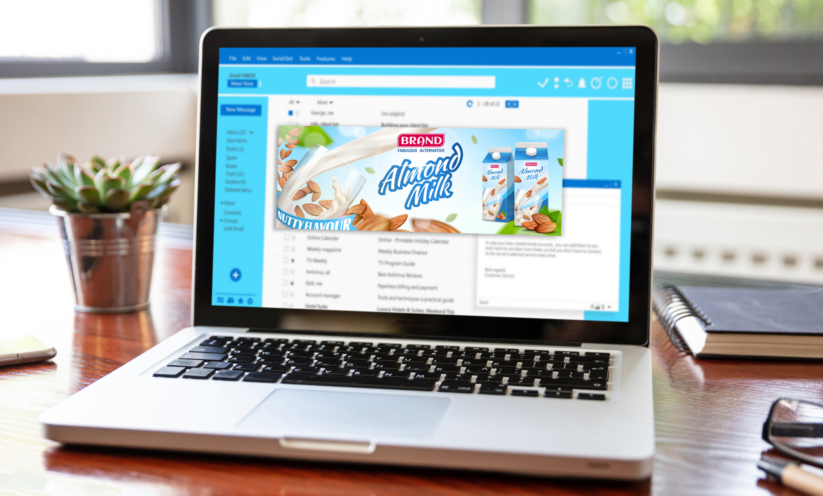

Our Offerings
Representation of the Digital Publishers in their Unrepresented Geography for Smarter Revenue
Brand Solutions
Programmatic Monetization
We drive Publishers Programmatic Monetization and Brand Solutions through our Representation service

Slide 5














Markets We Represents
1.96 Bn
People in 2021
1.68 Bn
People in 2021
675 Mn
People in 2021
Southern Asia
Eastern Asia
South-Eastern Asia
India
Nepal
Sri Lanka
China
Japan
Philippines
Thailand
Vietnam
Pakistan
Bangladesh
Taiwan
South Korea
Indonesia
Malaysia
= 100Mn people
Source: https://statisticstimes.com/demographics/asia-population.php

Slide 6





How We Drive Programmatic Monetization?
IncrementX represents publishers in the programmatic ecosystem
Open Market Yield Optimization
Whitelisting Sites & Apps
Aggregated PMPs
PGs
Working Directly on Publisher’s first party audiences and bundling them via various deals drives higher efficiency for brands and yields for publishers

Slide 7





How We Drive Brand Solution Revenue?
IncrementX offers brand solution demand to the publisher
Marketing Support
Local Sales Force
Direct connections and relationships
Direct Deals (IOs)

Slide 8












Our Ad Formats
Display Ads
Video Ads
Audio Ads
CTV/OTT Ads
DOOH Ads
High SOV Ads
Text Messages
Newsletters
Content Sponsorships
Social Outreach
Brand Engagement Solutions
Microsites

Slide 9


A GLIMPSE AT OUR SELECTED OFFERINGS

Slide 10



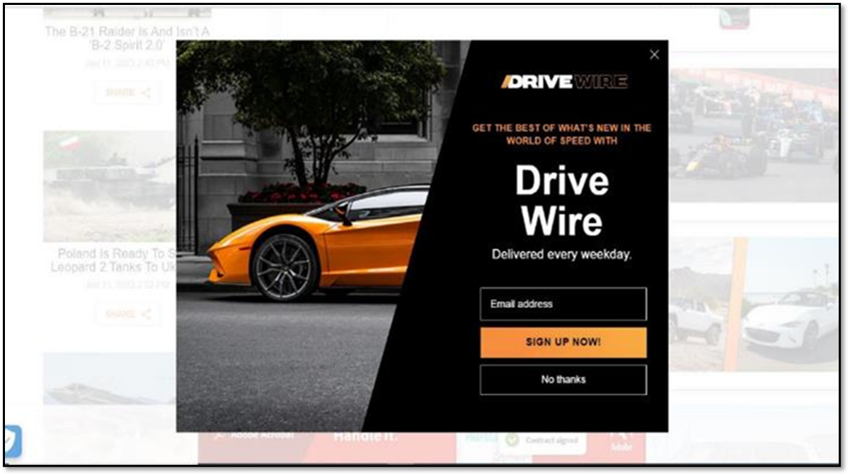
High Share Of Voice Ads - Full Page Interstitials
Desktop View
Mobile View
Notes:
SLIDE OPTION_1

Slide 11

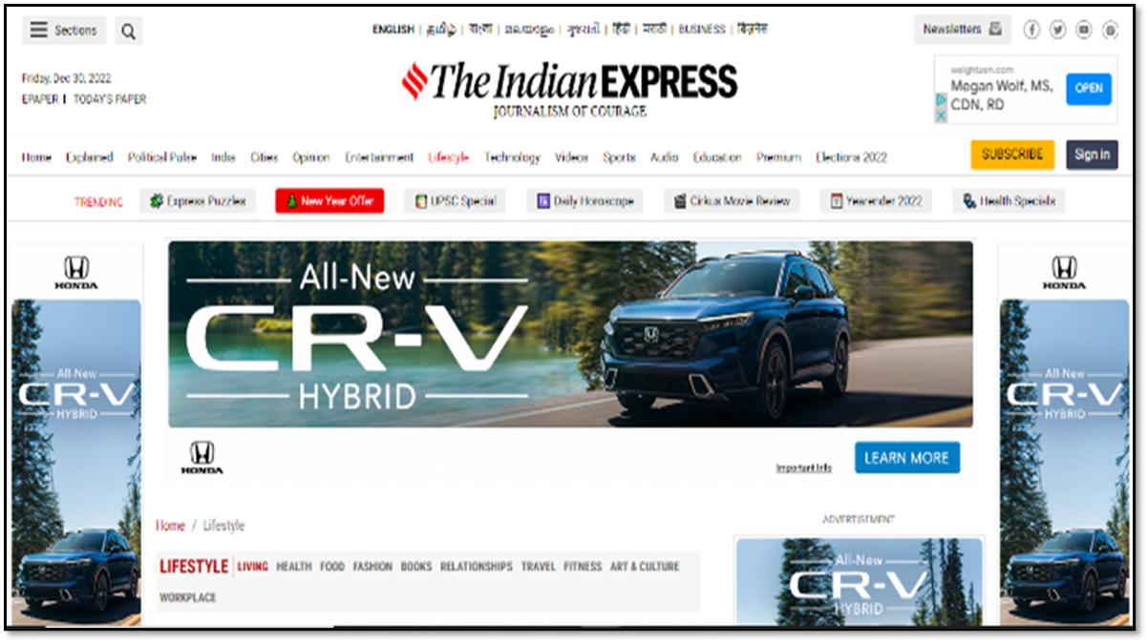
High Share Of Voice Ads - Home Page Take Overs (Hpto)
Desktop View
Mobile View

Slide 12
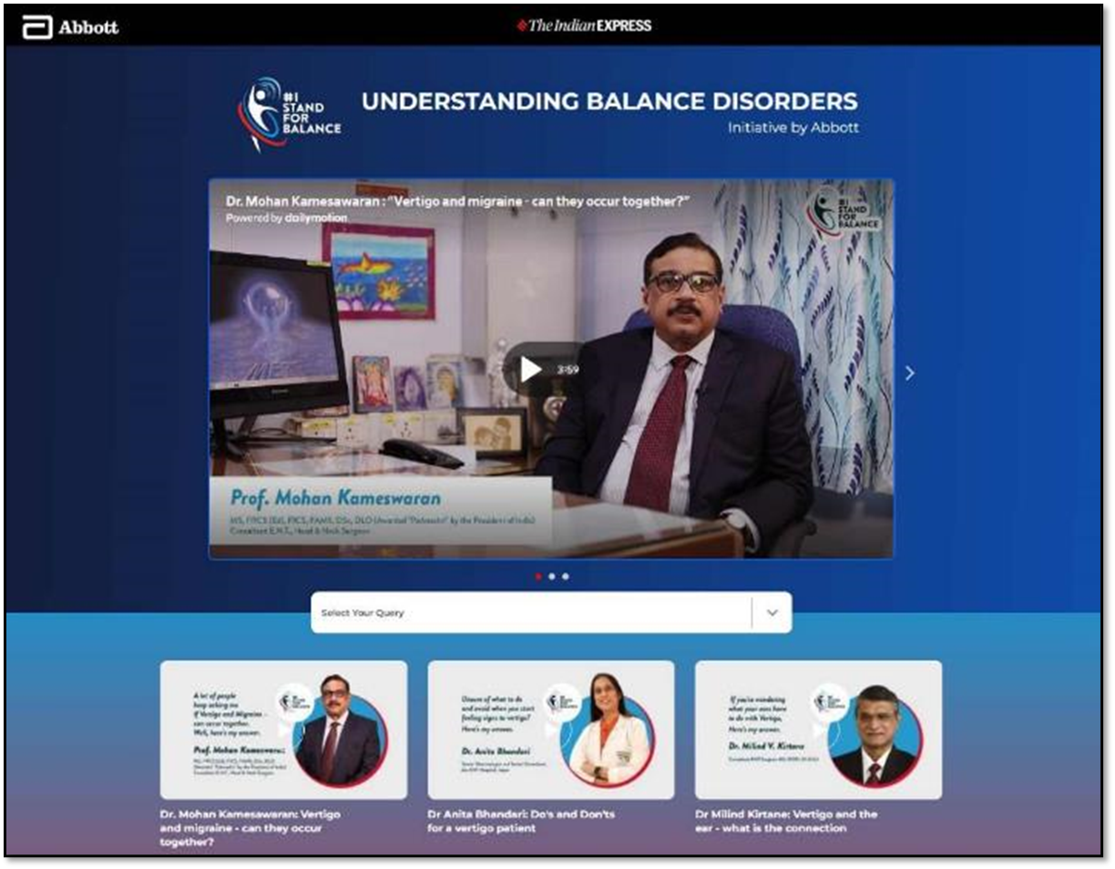
Microsites

Slide 13

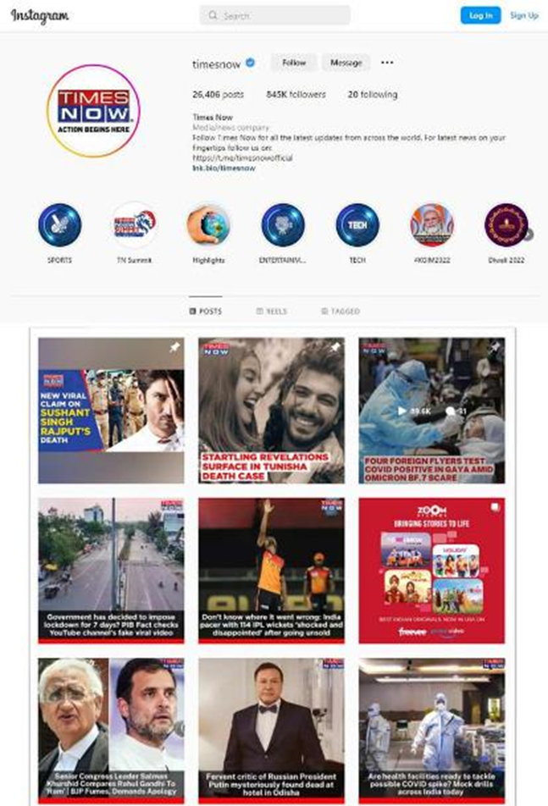

Social Outreach

Slide 14
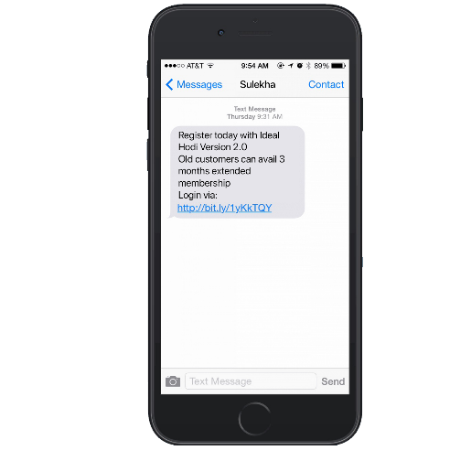

Text Messages & Newsletters
Text Messages
Newsletters

Slide 15


Our Integration Options
Programmatic Monetization
Brands Solutions
JS Tags
Header Bidding
Video-VAST Tags
Open RTB
Publisher Served – Custom Creative / Content

Slide 16
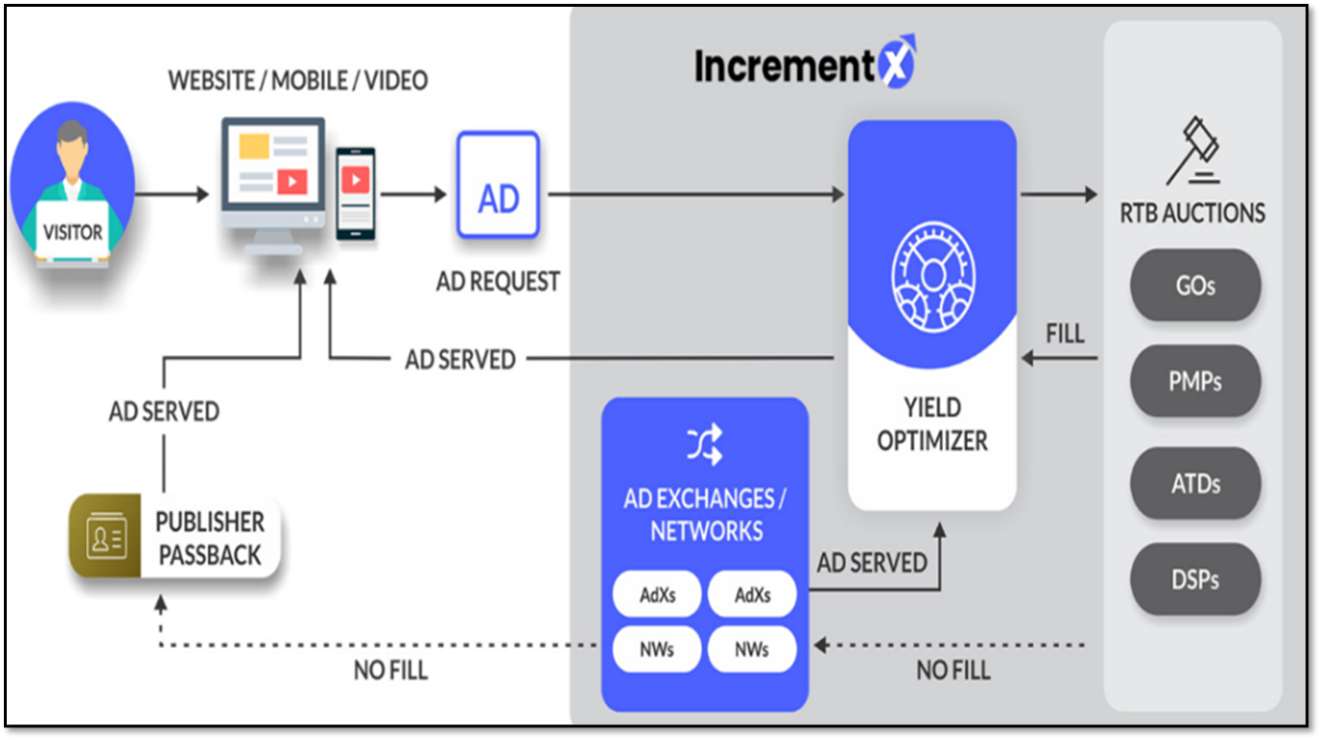
Proprietary Technology

Slide 17
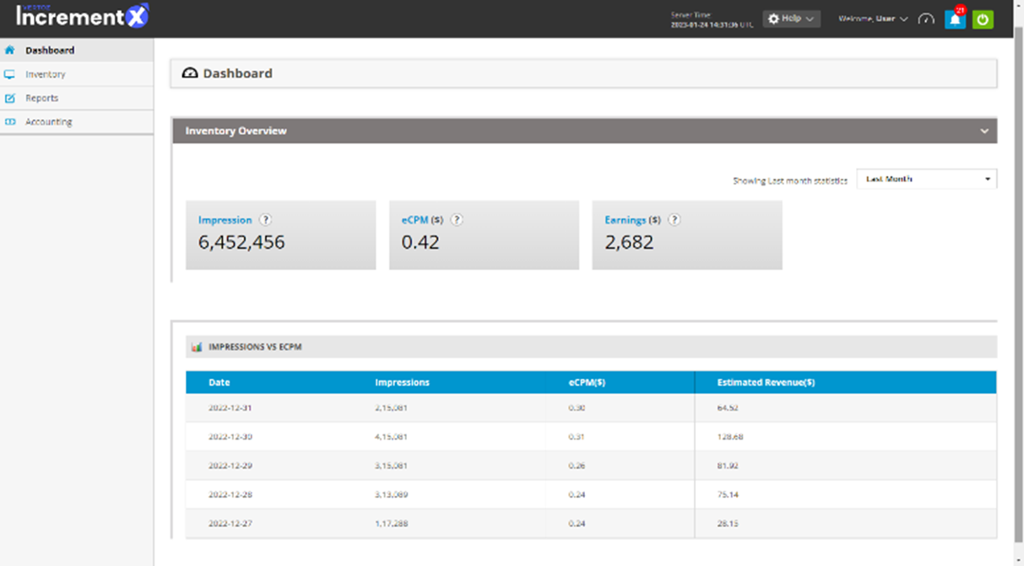
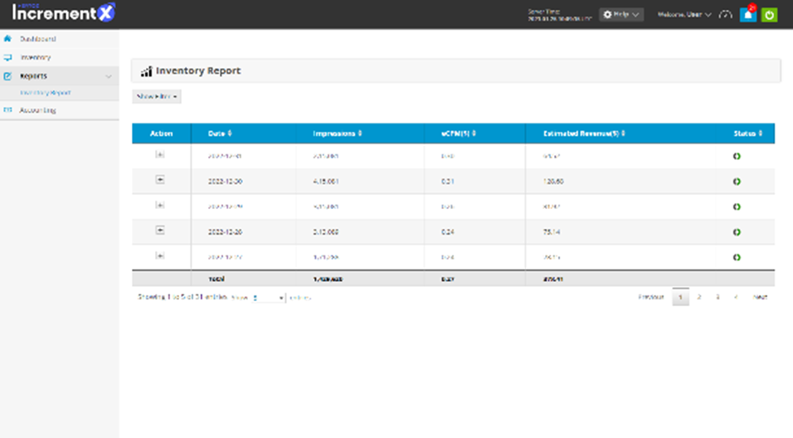
Our Console
Dashboard
Reports

Slide 18








Audience Segments
+200 Sub-audience Segments
Lifestyle
Entertainment
Personal Finance
Culture
Sports
High Net Worth
News
Education
Notes:
SLIDE OPTION 1

Slide 19





























Publishers Who Trust Us
We Represent Over 15+ Western Publishers
American, Canadian & British Publishers
& Many more…

Slide 20




















We Connect You To Top Brands & Agency
Notes:
Put some Agency – WPP / IPG / RPA / Mindshare / Innitiative etc..

Slide 21




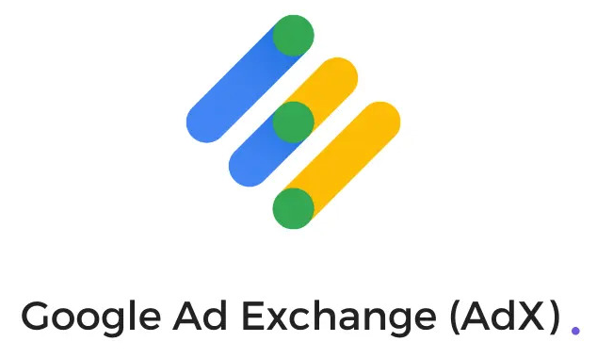



Select Demand Partners
Notes:
Update this Image – Show Partners – Handshake type image

Slide 22





Our Proposal
We are true believers of “the Skin in the Game in partnership model” and our proposal is structured accordingly
Open Market Monetization (Programmatic)
PMPs/PGs (Programmatic)
Direct Deals (Brand Solutions)
Up-to 80%
Up-to 70%
Up-to 60%
Revenue Share
30 to 45 Days
30 to 45 Days
Based on Collection – Generally 60-90 Days
Payment Terms
Notes:
Open Market upto 90%
PMP & PG upto 75%
Brand Solutions - Customized

Slide 23








Why IncrementX?
Value Creation - Matching right demand
Awareness in Unrepresented Market
Direct Brand & Agency Demand
Local Demand Partner
Niche Audience Aggregator
Audience Bucketing
Extended Local Team
Premium, Unique Demand

Slide 24
Mutual Action Plan
Milestone/Task
Owner
Introduction - 30 Mins | IX PD + Publishers
Representation MSA Execution | Publisher
Ads.txt & Google MCM Invite | IX Ad Ops Team
Tags Implementation - Test Page | Publisher
Inventory Review with Sales Team | IX PD & SD Team + Publisher
Go Live – 5% of US,CA & UK Traffic | Publisher
Brand Solution – Prices Review | IX PD & SD Team + Publisher
Scale Up Traffic | Publisher
First IO / Deals | IX PD & SD Team
Notes:
Open Market upto 90%
PMP & PG upto 75%
Brand Solutions - Customized

Slide 25

Global Presence
Vertoz Inc
1250 Broadway, Suite 3611, New York City,
New York - 10001, USA.
T +1 646 895 6969
Vertoz Advertising FZ-LLC
EX-34, Ground Floor, Bldg 16,
Dubai Internet City,
Dubai - 73000, UAE
Vertoz Inc
50 California Street Suite 1500,
San Francisco,
CA 94111 USA.
T +1 415 300 4333
Vertoz Advertising Ltd
602, Avior, Nirmal Galaxy,
LBS Marg, Mulund West,
Mumbai – 400080, India
T +91 22 6142 6030
Vertoz Ltd
Kimberley House,
31 Burnt Oak Broadway,
Edgware, Greater
London – HA8 5LD, UK
T +44 20 3318 4422

Slide 26

Thank You

