Slide 1
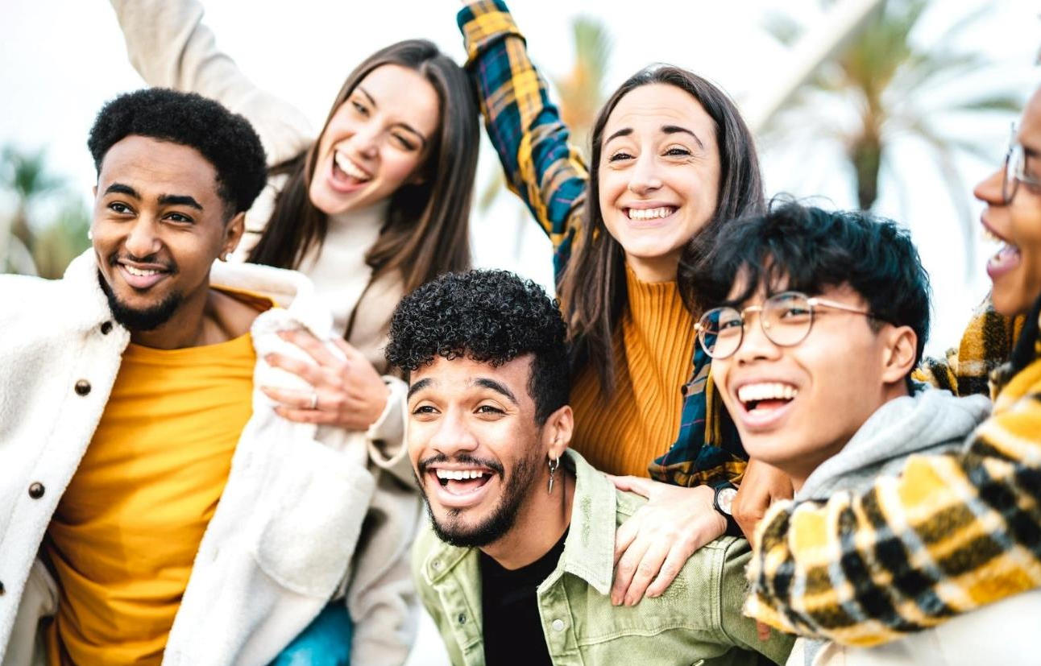



Niche
British Asian Audiences

Slide 2








We Represent British Asian Ethnicities
The term “British Asian” encapsulates dozens of ethnic groups of Asian descent.
The Asian population is a diverse group, with origins from more than 20 countries in East Asia & Southeast Asia.
Approximately 5.5 Million Asians make up 9.3% of the total population of England & Wales in 2021.
1.8M
1.5M
645K
445K
972K
…
Indian
Pakistani
Bangladeshi
Chinese
Other Asians
Source: https://www.ethnicity-facts-figures.service.gov.uk/uk-population-by-ethnicity/national-and-regional-populations/population-of-england-and-wales/latest
Notes:
www.ons.gov.uk

Slide 3
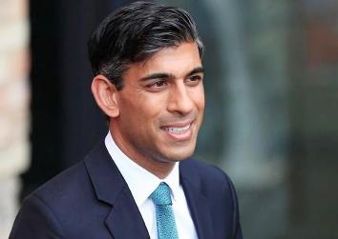
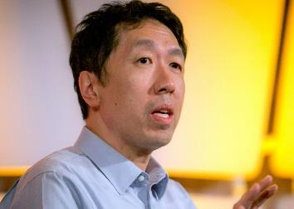

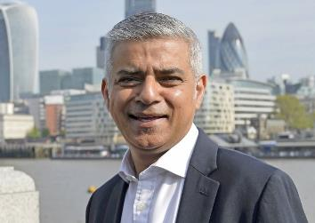
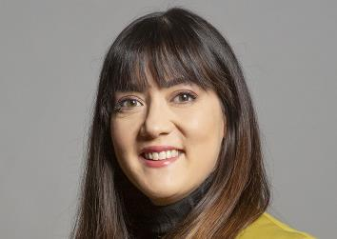
Reaching Niche British Asian
Early Tech Adopters, Highly Educated And Affluent
Sadiq Khan
[Pakistani Origin]
Sarah Mei Li Owen
[Multicultural Asian]
Mayor of London
Member of Parliament (MP)
Rishi Sunak
[Indian Origin]
Andrew Yan-Tak Ng
[Chinese Origin]
Ben Kingsley
[Indian Origin]
Prime Minister of the United Kingdom
Chairman & Co-Founder
of Coursera
Actor

Slide 4
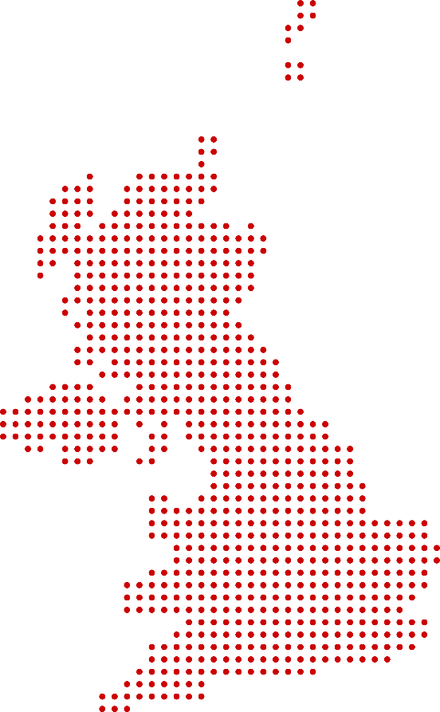
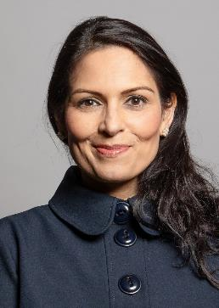

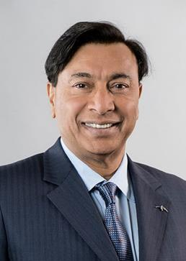
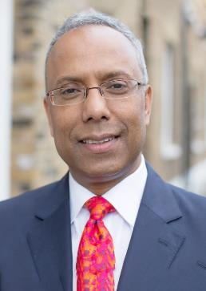

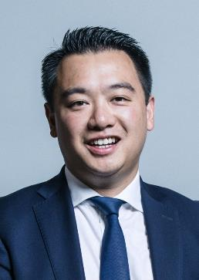
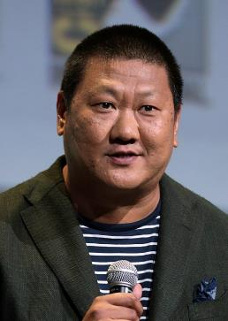
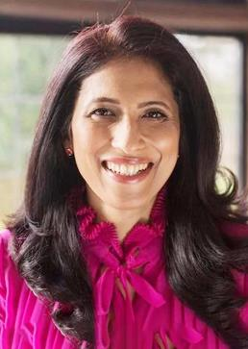

We Deliver The British Asian Market
The Asian market is growing and has arrived!
Priti Patel
British - Home Secretary
[Indian Origin]
Riz Ahmed
Actor
[Pakistani Origin]
Lakshmi Mittal
Steel Magnate
[Indian Origin]
Lutfur Rahman
Mayor of Tower Hamlets
[Bangladeshi Origin]
Alan Mak
MP for Havant, member of the House of Commons
[Chinese Origin]
Benedict Wong
Actor
[Hong Kong Origin]
Leena Nair
Global CEO Chanel [Indian Origin]
Anya Chalotra
Actress
[Indian origin]

Slide 5
British Asian –
A Rapidly Growing Market
Ethnic group distribution 2011 and 2021, England & Wales
Asian, Asian British or Asian Welsh
7.5% (4.2 million)
British Asians accounted for 9.3% of the total population in 2021.
9.3% (5.5 million)
British Asian had the largest increase in population
From 7.5% in 2011 to 9.3% of total population in 2021.
Black, Black British, Black Welsh, Caribbean or African
3.3% (1.9 million)
4.0% (2.4 million)
Indians remain the largest Asian Ethnic group in UK.
British Indian population has increased 32% since 2011.
2.2% (1.2 million)
2011
Mixed or Multiple ethnic groups
2.9% (1.7 million)
2021
Pakistani-origin people make up the second largest Asian Ethnic group.
Pakistani ethnicity had a 41% increase in population since 2011.
1.0% (564,000)
Other ethnic group
2.1 % (1.3 million)
Source; https://www.ons.gov.uk/peoplepopulationandcommunity/culturalidentity/ethnicity/bulletins/ethnicgroupenglandandwales/census2021#ethnic-groups-in-england-and-wales
Notes:
Around 2.5 million households contain members from at least 2 different Asian ethnic groups.
SOURCE: https://www.ons.gov.uk/peoplepopulationandcommunity/culturalidentity/ethnicity/bulletins/ethnicgroupenglandandwales/census2021#ethnic-groups-in-england-and-wales

Slide 6
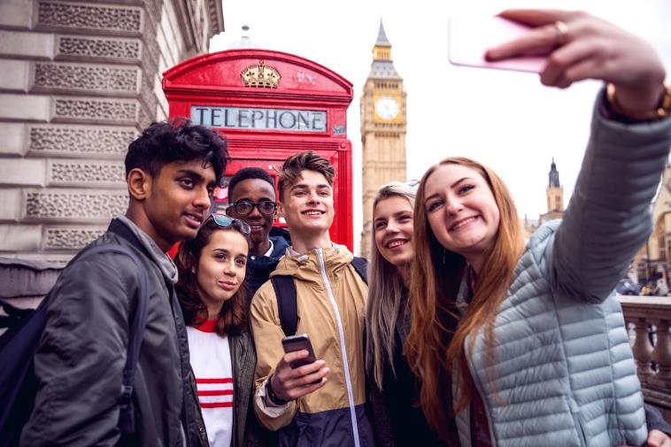





Why Asian Audience?
AGE
INCOME
The Asian ethnic groups have an average age of 29 years .
Asian households in the UK had the highest proportion of income. Earning more than 1,000 pounds a week.
GENDER
EDUCATION
Asian ethnic group gender percentage ratio was Male: 49% Female: 51%
Indian, Pakistani, & Bangladeshi youngsters have higher educational qualifications than other majorities.
Source: https://www.ethnicity-facts-figures.service.gov.uk/education-skills-and-training/higher-education/entry-rates-into-higher-education/latest
Notes:
In 2021, 72.1% of students from Chinese ethnic group got a higher education place in the UK – the highest entry rate out of all ethnic group

Slide 7
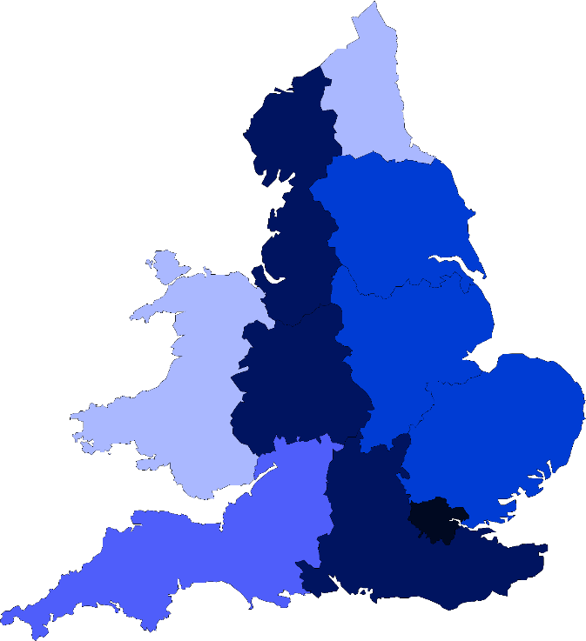

Asians In UK
Asian Population in the UK, by region.
Ethnic groups by area England and Wales (2011).
<1.9%
2-4.9%
Northeast
5-9.9%
10-24.9%
Northwest
>25%
Yorkshire & The Humber
Wales
East Midlands
West Midlands
Most British Asians are concentrated in the Greater London & West Midlands areas. Followed by Northwest & Southeast regions. Least Asian population is seen in Wales & Northeast.
East of England
Southwest
London
Southeast
Source: https://www.researchgate.net/profile/Bethany-Toma/publication/328861101/figure/fig1/AS:691532764045312@1541885667268/Map-of-NUTS-1-regions-in-the-UK-3.ppm
Notes:
https://www.mappr.co/wp-content/uploads/2022/07/regions-england-map-891x1024.jpeg
https://www.researchgate.net/profile/Bethany-Toma/publication/328861101/figure/fig1/AS:691532764045312@1541885667268/Map-of-NUTS-1-regions-in-the-UK-3.ppm
https://www.ethnicity-facts-figures.service.gov.uk/uk-population-by-ethnicity/national-and-regional-populations/regional-ethnic-diversity/latest#areas-of-england-and-wales-by-ethnicity

Slide 8
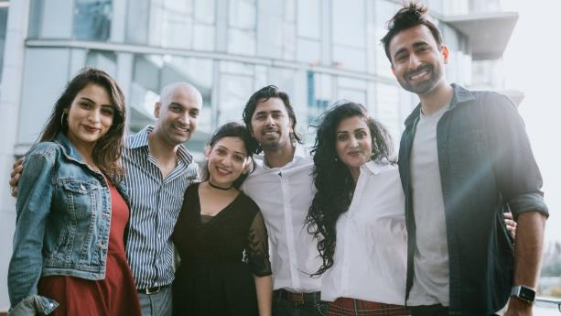
Opportunity - Educated, Young & Leaders Of Tomorrow.
2.9M
Students
114.4B
Pounds
Approx 2.9 Million Asian Students got a higher education place
The Median Age of British Asian is
29
Asian Owned Businesses had combined revenue of 114.4 Billion Pounds
Source:
https://www.ethnicity-facts-figures.service.gov.uk/education-skills-and-training/higher-education/entry-rates-into-higher-education/latest
Source:
https://www.ethnicity-facts-figures.service.gov.uk/uk-population-by-ethnicity/demographics/age-groups/latest
Source:
https://economictimes.indiatimes.com/news/company/corporate-trends/indian-firms-register-revenue-and-job-growth-in-uk-finds-india-meets-britain-tracker/articleshow/91373905.cms?from=mdr
Notes:
In 2021, 72.1% of students from Chinese ethnic group got a higher education place in the UK – the highest entry rate out of all ethnic group

Slide 9



Asian Affluency
Contribute to Economy
Asian owned businesses have an important impact on UK’s economy.
Businesses owned by Chinese nationals had a combined turnover of £60 Billion.
A total of 900 Indian owned businesses made £54.4 Billion.
Nearly 176K people were employed by Asian businesses in 2021-22.
Businesses led by ethnic-minority entrepreneurs contribute at minimum £74 billion a year to the UK economy.
Source: https://economictimes.indiatimes.com/news/company/corporate-trends/indian-firms-register-revenue-and-job-growth-in-uk-finds-india-meets-britain-tracker/articleshow/91373905.cms?from=mdr
Notes:
https://www.consultancy.uk/news/30650/chinese-owned-businesses-create-60000-jobs-in-uk#:~:text=Businesses%20owned%20by%20Chinese%20nationals,60%2C000%20jobs%20across%20all%20industries.

Slide 10

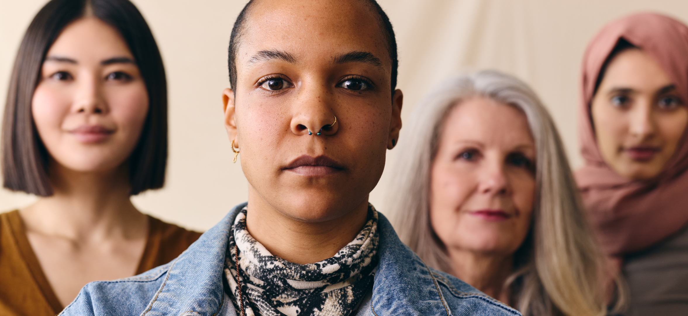


Multicultural Marketing Is Mainstream Marketing
“I’m proud to champion our holistic approach and broader company efforts to build a truly inclusive workplace environment for all.”
“Inclusion isn’t just about how diverse our colleagues are at Bloomberg; it’s about how we treat everyone when they are here. It’s about small acts of understanding, performed every day at every level.”
Peter Grauer
Chairman of Bloomberg,
“A more diverse newsroom enhances our journalism, providing greater perspectives, reporting avenues and deeper understanding of the world around us.”
Alessandra Galloni – Reuters
Global Managing Editor

Slide 11


Slide 12




















Brand Who Buy Asian Audiences

Slide 13



















































Our Premium Asian Publishers Network
South Asian
(India, Pakistan, Bangladesh, Nepal, Shri Lanka)
Southeast & East Asian
(China, Japan, Vietnam, Philippines, South Korea, Indonesia )
Creaders
Radiokorea
Bangladesh Pratidin
Urdu Point
Dainik Bhaskar
Punjab Kesari
The Korea Daily
Dinamalar
Prothom Alo
Missyusa
The Korea Times
Sandesh
Vikatan
FM Korea

Slide 14








Helping You Reach This Niche Audience
250MN+
Video Imp (Mo)
200MN+
Display Imp (Mo)
18+
General Market
450MN+
Total Impressions (Mo.)
3.75MN+
Reach/Uniques
300+
Premium Publishers

Slide 15



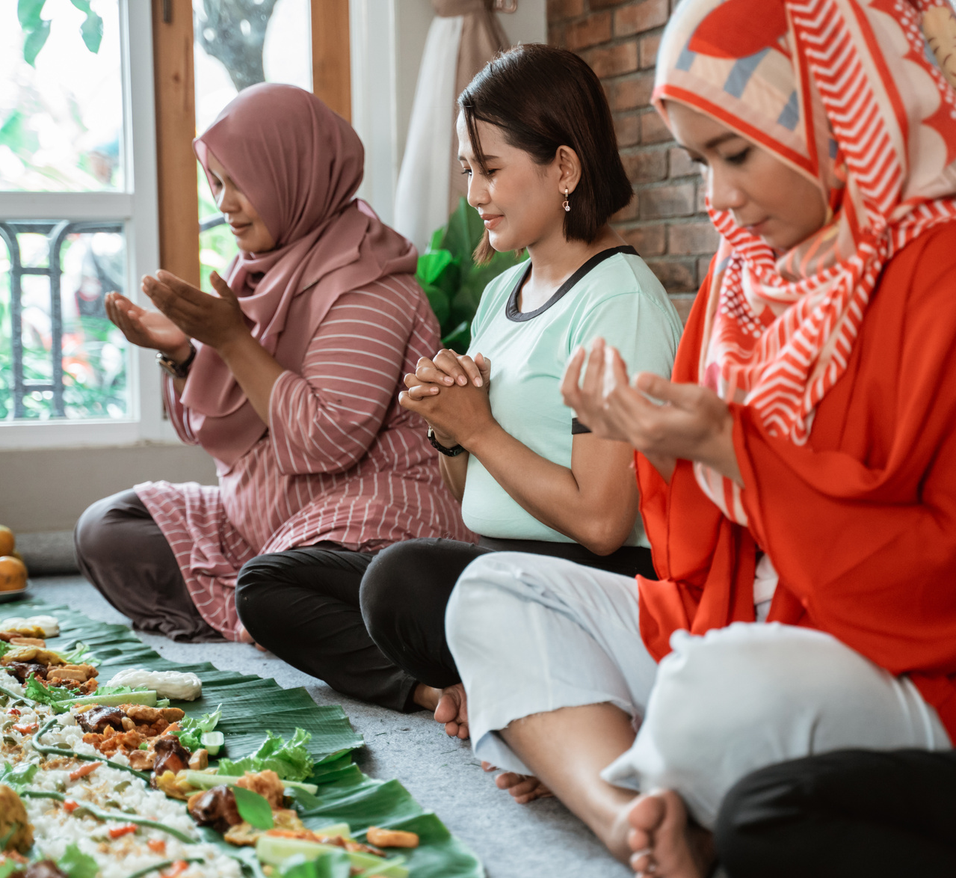
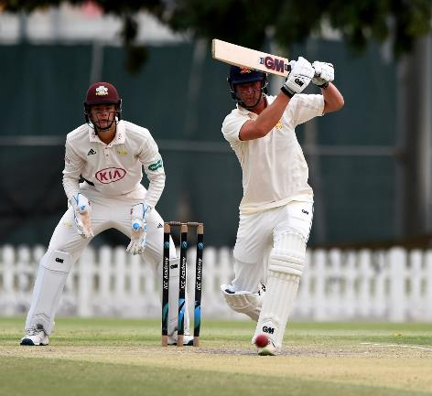

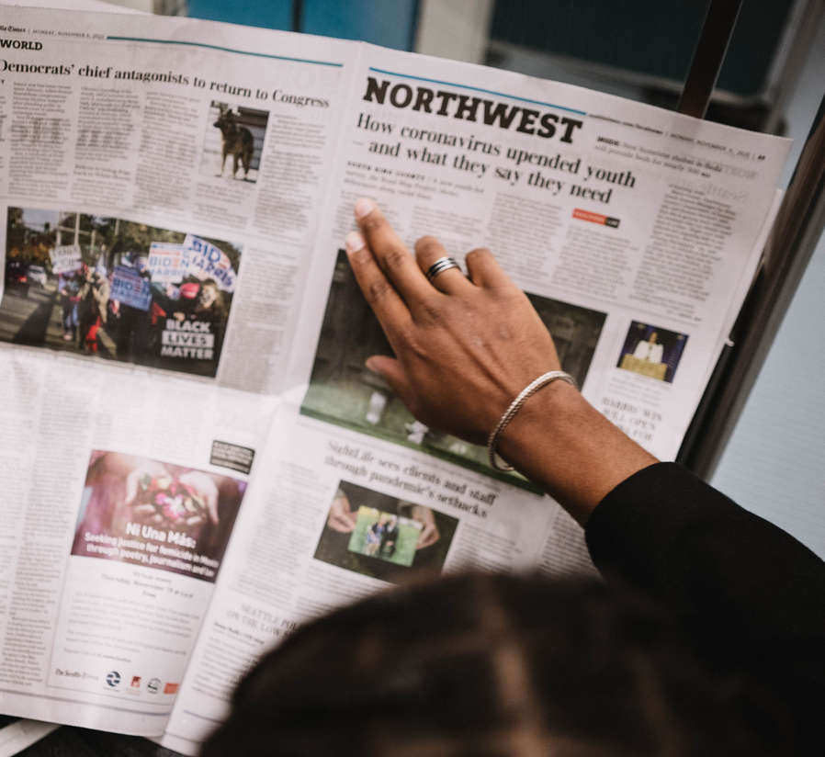

Lifestyle
Entertainment
Personal Finance
Culture
Our Primary Audience Segments
+200 Sub-audience segments
Sports
High Net Worth
News
Education
Notes:
SLIDE OPTION 1

Slide 16













Display Ads
Video Ads
Audio Ads
CTV/OTT Ads
DOOH Ads
High SOV Ads
Our Offerings
Text Messages
Content Sponsorships
Social Outreach
Brand Engagement Solutions
Newsletters
Microsites

Slide 17
A Glimpse At Our Selected Offerings

Slide 18
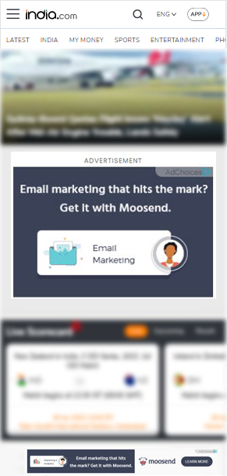
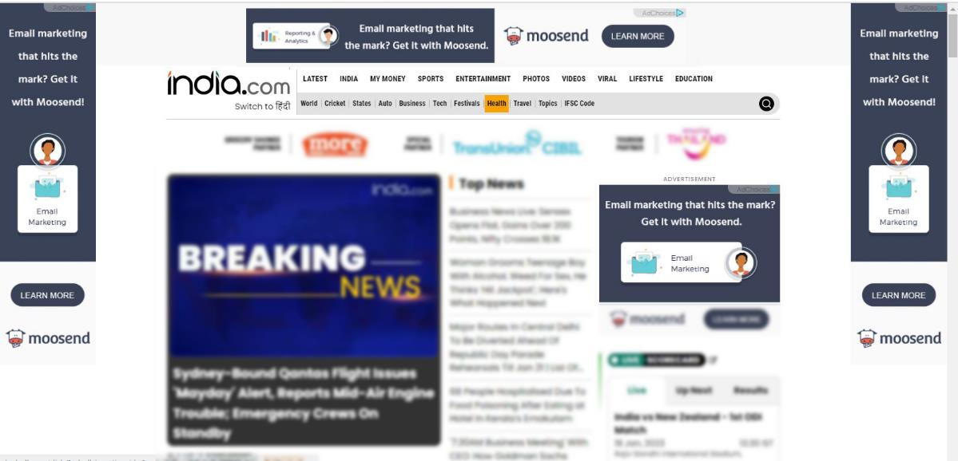
High Share Of Voice Ads
Home Page Take Over
Desktop View
Mobile View

Slide 19
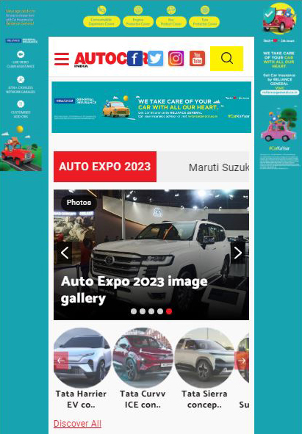
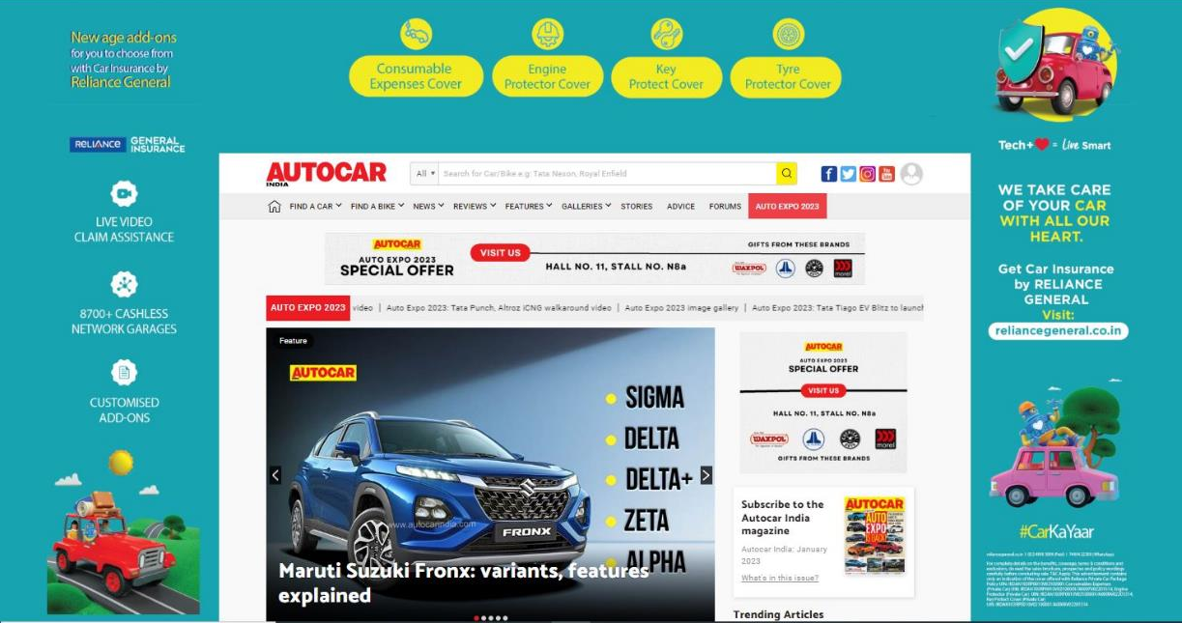
High Share Of Voice Ads
Desktop View
Mobile View

Slide 20
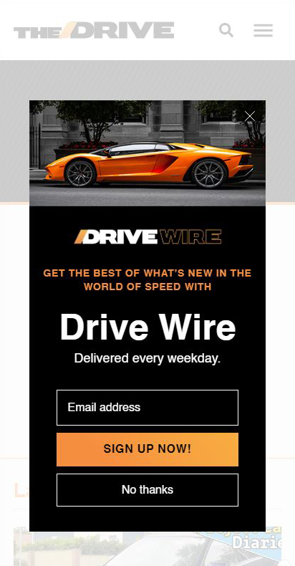
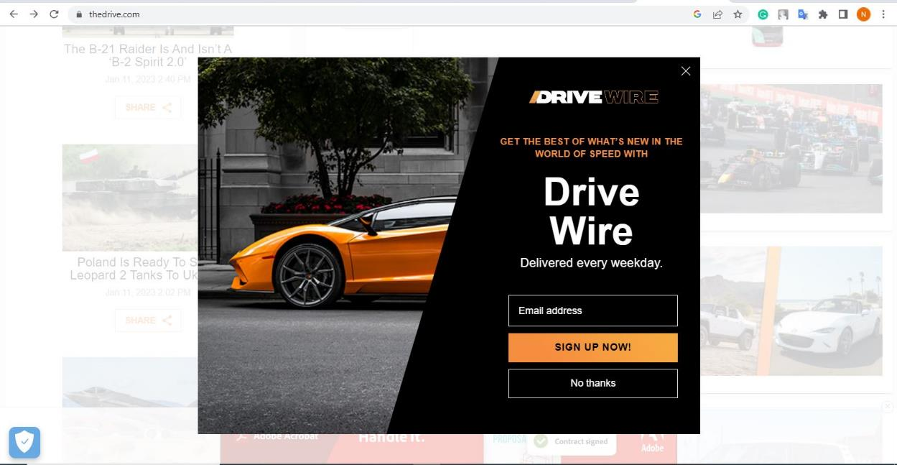
High Share Of Voice Ads
Full Page Interstitial
Desktop View
Mobile View

Slide 21
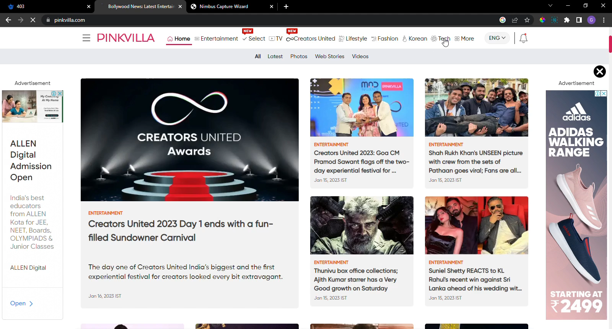
Content Sponsorships
Brand sponsored articles on well known websites.
Brand OnePlus Sponsored articles with Indian publisher Pinkvilla

Slide 22
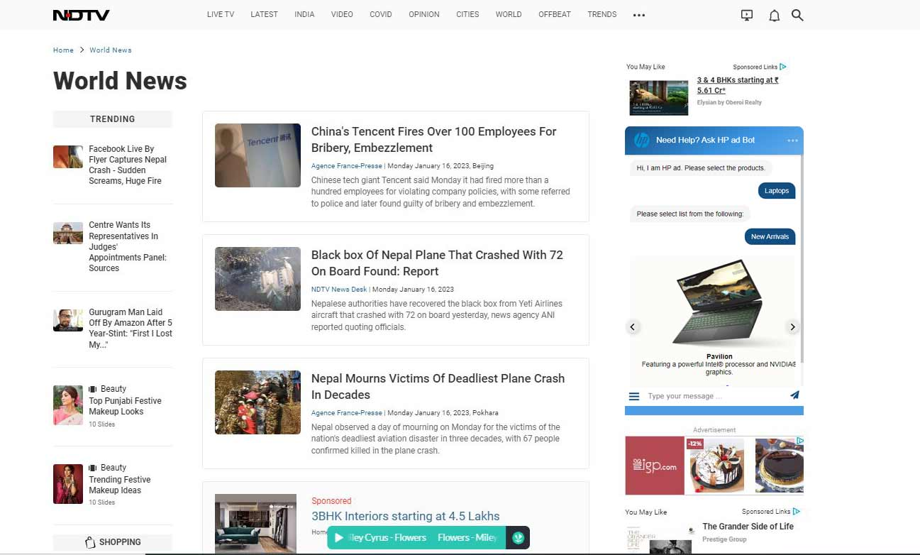
Brand Engagement Solutions
Chatbot Creative

Slide 23
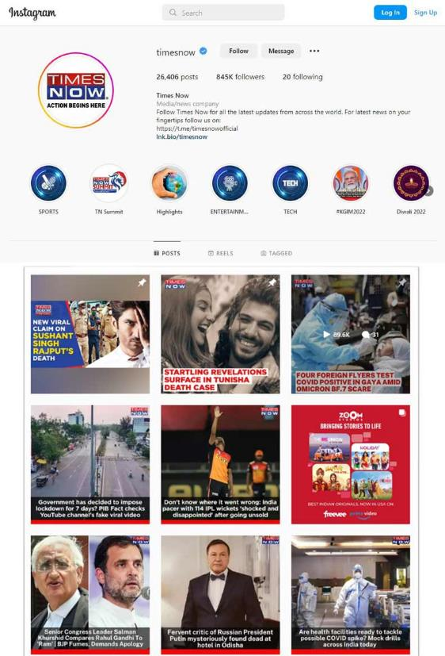
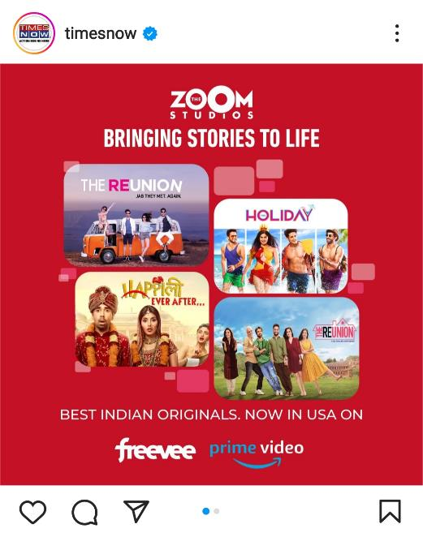
Social Outreach
Sponsored social media segments: Carousels, Videos, Reels & more tagged with the brand’s social handle.

Slide 24
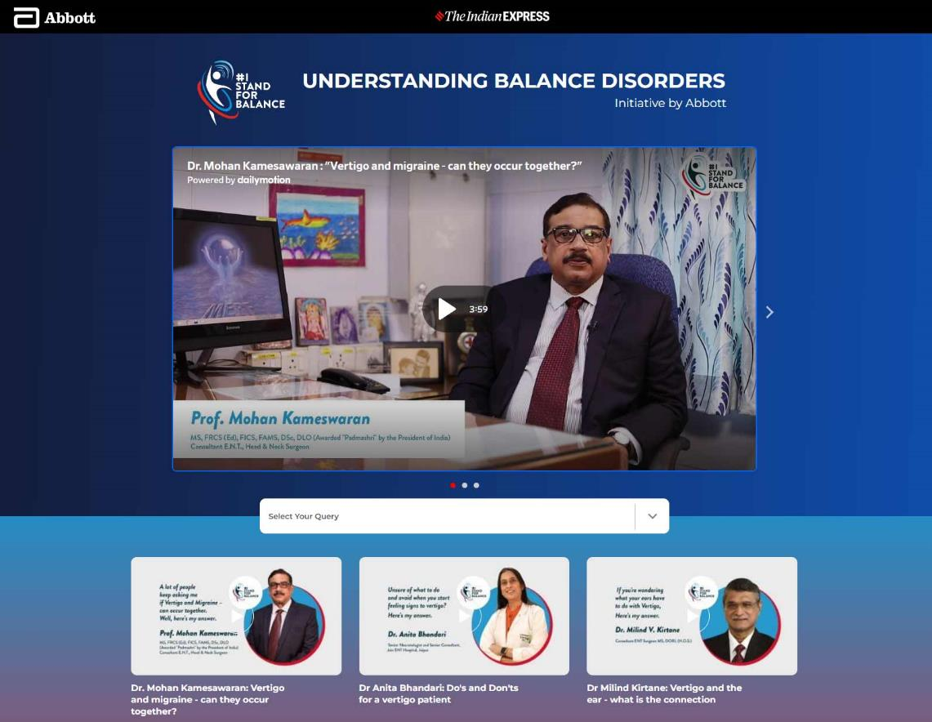
Microsites

Slide 25
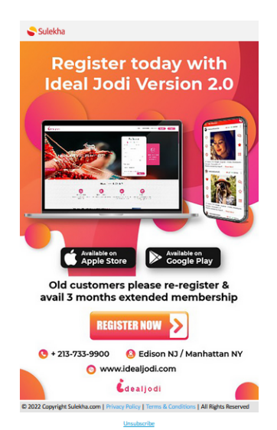
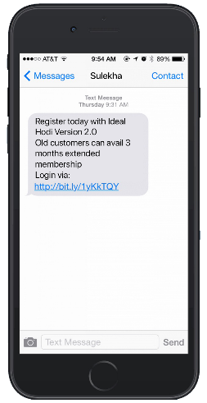
Text Messages & Newsletters
Text Messages
Newsletters

Slide 26
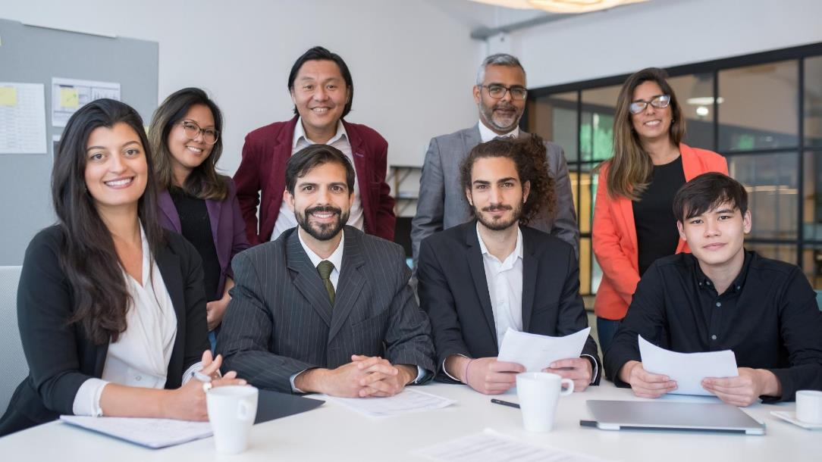




How We Can
Work Together?
Managed Media Buy
v
PMP & PG Available
via
Programmatic Pipes

Slide 27
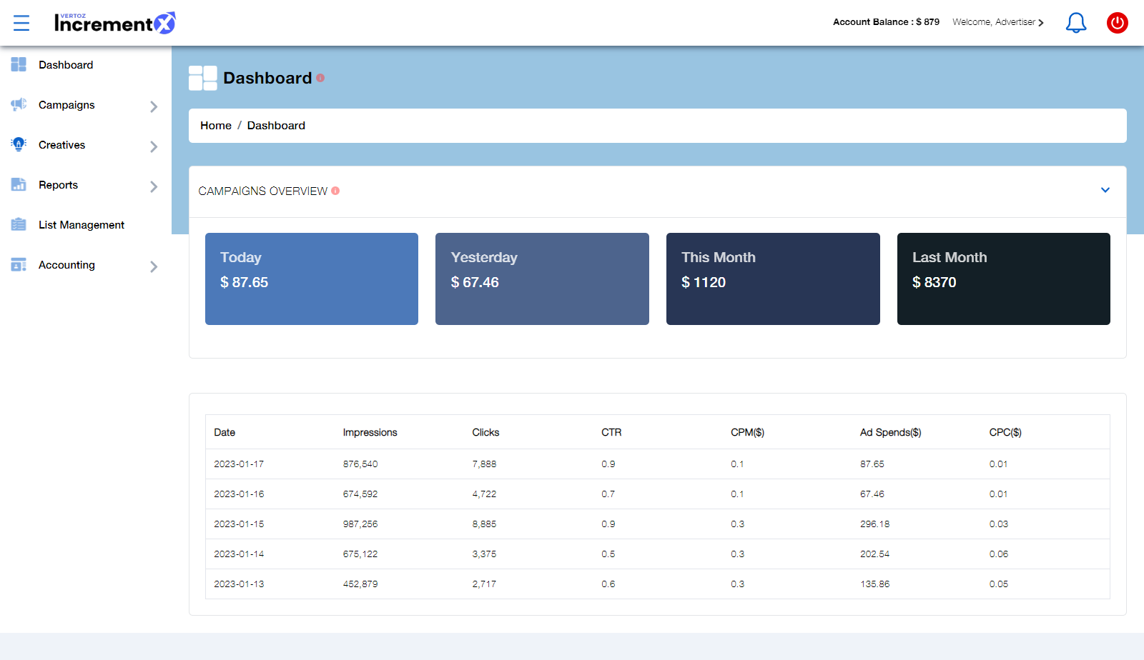
Our Technology
Advertisers Dashboard

Slide 28






Our Targeting Capabilities
Ethnicity
Geo Targeting
Direct connect to Asian audience consumer behavior
State / DMA / City / Postal Code
Contextual Category
Audience Buckets
Sites & Apps
Entertainment / Autos & Vehicles / Beauty & Fitness / Books & Literature
Finance / Health / News / Online Communities /
Leisure / Sports / Travel
News 18 / Indian Express / China Times / Korean Radio

Slide 29











Why IncrementX?
One Stop Solution - Asian Audience
First Party Audience Buckets
Local Support
Cultural Knowledge
Multiple Languages
Delivery, Quality & Scale
Innovations & Ad formats
Experience
Technology

Slide 30


About IncrementX
IncrementX is the technology led Niche audience platform representing Asian Digital Publishers in their unrepresented geography.
IncrementX is the Programmatic Monetization and Brand Solutions Partner for Publishers.
We provide a global sales force, partnerships & technologies unique expertise to minimize the surprises publishers face in unrepresented geographies.
IncrementX is Part of Vertoz Group (NSEI: VERTOZ)

Slide 31
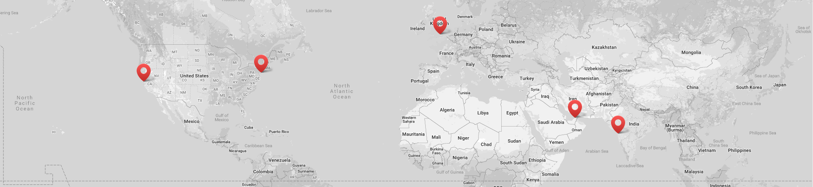





Global Presence
Vertoz Inc
Vertoz Inc
Vertoz Ltd
Vertoz Advertising FZ-LLC
Vertoz Advertising Ltd
1250 Broadway,
Suite 3611,
New York City,
New York - 10001, USA.
T +1 646 895 6969
50 California
Street Suite 1500,
San Francisco,
CA 94111 USA.
T +1 415 300 4333
Kimberley House,
31 Burnt Oak Broadway,
Edgware, Greater
London – HA8 5LD, UK
T +44 20 3318 4422
EX-34,
Ground Floor, Bldg 16,
Dubai Internet City,
Dubai – 73000, UAE
602, Avior,
Nirmal Galaxy,
LBS Marg, Mulund West,
Mumbai – 400080, India
T +91 22 6142 6030

Slide 32


Thank You

