Slide 1



v
Niche
Asian Canadian Audiences

Slide 2

















We Represent Asian Canadian Ethnicities
As of 2021, 7 million Canadians were of Asian geographical descent
2.6M
1.7M
960K
South Asians
Chinese
Filipinos
1.4M
220K
99K
Others (Southeast & West Asian, Middle East Asian)
Koreans
Japanese
Singapore, Vietnam, Indonesia, Taiwan, UAE… etc
Source: https://www150.statcan.gc.ca/n1/daily-quotidien/221026/dq221026b-eng.htm

Slide 3
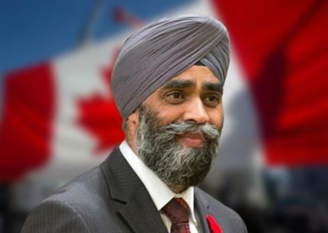
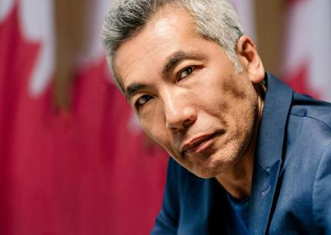
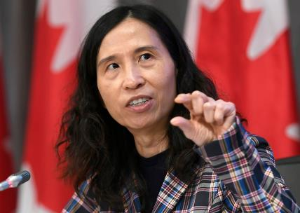

Reaching Niche Asian Canadians
Early Tech Adopters, Highly Educated And Affluent
Dr. Theresa Tam
Sandra Oh
Chinese Canadian Public Health Leader
Canadian American actress
Harjit Sajjan
Hironobu Kanagawa
Minister of International Development of Canada
Japanese Canadian Actor

Slide 4

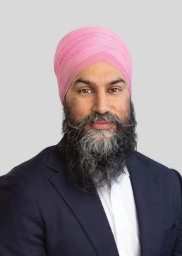
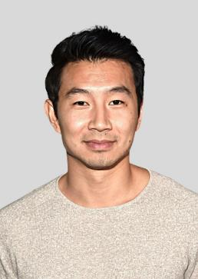
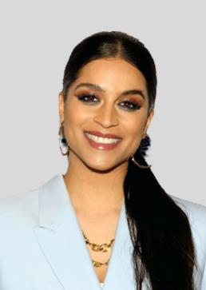


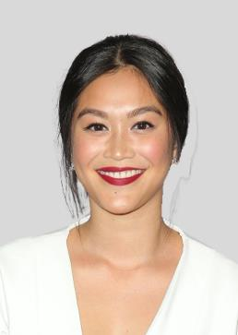

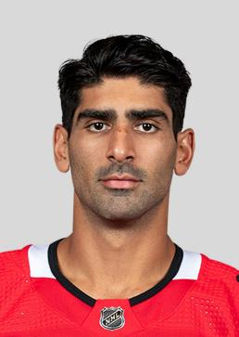

We Deliver The Asian Canadian Market
The Asian market is growing and has arrived!
Jagmeet Singh
Politician
(Indian Origin)
Simu Liu
Actor
(Chinese Origin)
Lily Singh
TV Show Host
(Indian Origin)
Hazel Mae
Sports Presenter
(Filipino Origin)
Christy Chung Actress
(Vietnamese Origin)
Dianne Doan
Actress
(Vietnamese Origin)
Paul kariya
Ice Hockey Player
(Japanese Origin)
Jujhar Khaira
Ice Hockey Player
(Indian Origin)

Slide 5
Asian Canadian
A Rapidly Growing Market
Asians make up 19.3% of the Canadian Population.
India is the leading country of birth for recent immigration to Canada
Asian Canadian population rose from 10.9% in 2001 to 19.3% in 2021.
1.9 Million Indians are currently residing in Canada.
18.6%
2021
12.1%
2016
By 2036, Almost 57.9% of Canada’s immigrant population would be Asian-born.
Source: https://www.statcan.gc.ca/en/dai/smr08/2021/smr08_250
Source: https://economictimes.indiatimes.com/nri/migrate/immigrants-make-up-largest-share-of-canadas-population-in-countrys-history-india-takes-top-spot-among-newcomers/articleshow/95110915.cms
Notes:
Slide Option 2
https://www.statcan.gc.ca/en/dai/smr08/2021/smr08_250
https://www.livemint.com/news/india/indians-constitute-18-of-new-immigrants-in-canada-likely-to-move-up-report-11666870422894.html
https://www.linkedin.com/pulse/immigrants-children-set-dominate-canada-population-colin-r-/?trk=organization_guest_main-feed-card_feed-article-content
https://economictimes.indiatimes.com/nri/migrate/immigrants-make-up-largest-share-of-canadas-population-in-countrys-history-india-takes-top-spot-among-newcomers/articleshow/95110915.cms
https://www.ctvnews.ca/canada/record-share-of-canadians-are-immigrants-or-permanent-residents-census-shows-1.6125309

Slide 6



Why Asian Audience?
Immigration has resulted in a younger Canadian population for the first time in over half a decade.
Asians are the top earners and the most educated in Canada.
Median pay for immigrants was CA $32K in 2019.
10.9% of the new immigrants are youngsters aged 15 to 24.
The employment rate for Filipino Canadians was 88.3% in 2019.
A total of 215K study visas awarded to Indian students in 2021
Study visas awarded to Filipino students rose by 115% in 2021.
Source: https://thinkcultural.com/asian-canadians-income-levels/
Source: https://www.livemint.com/news/india/indians-constitute-18-of-new-immigrants-in-canada-likely-to-move-up-report-11666870422894.html

Slide 7
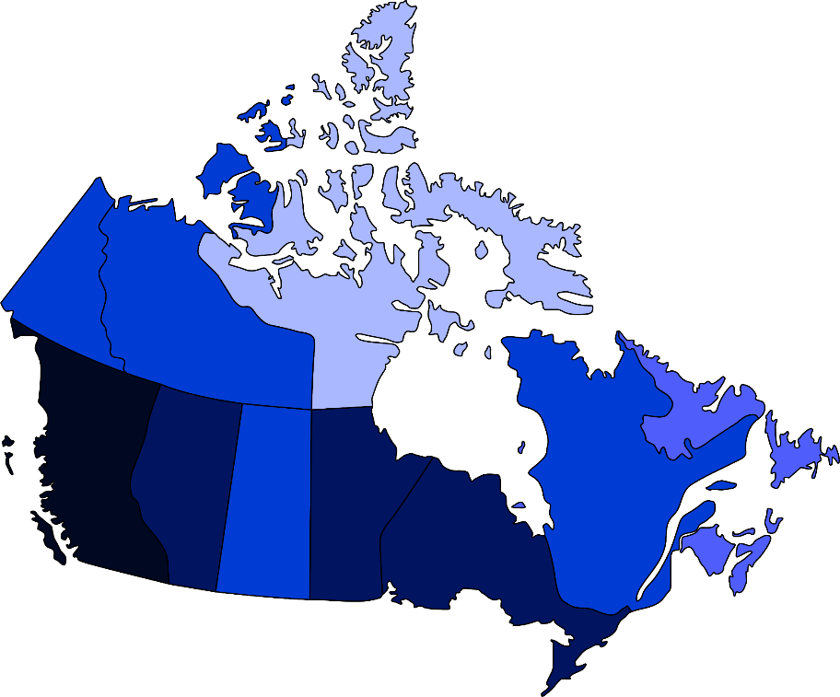

Asians In Canada
Major Markets.
< 1.9%
2.0 - 4.9%
5.0 - 9.9%
10.0 - 24.9%
> 25.0%
Most Asian Canadians are concentrated in the urban areas of Southern Ontario, Southwestern British Columbia, Central Alberta, and other large Canadian cities.
Source: https://en.wikipedia.org/wiki/Asian_Canadians#/media/File:Asian_ancestry_in_Canada.png

Slide 8






Opportunity - Educated, Young & Leaders Of Tomorrow.
By 2041, Asian immigrants will make up more than a third of all Canadians.
1 in 10 recent Asian immigrants were youth and young adults aged 15 to 24.
Nearly 60% of working-age Asian immigrants hold a bachelor's degree or higher.
Source: https://www150.statcan.gc.ca/n1/daily-quotidien/221026/dq221026a-eng.htm
Source: https://www.immigration.ca/immigrants-and-their-children-set-to-dominate-canada-population-by-2041/

Slide 9




Multicultural Marketing Is Mainstream Marketing
We all need to do our part. P&G has committed to be the number one spender in all multiculturally-owned media, AND to take steps to significantly expand the ecosystem. We are investing, and if we all invest, we will make the media market bigger, and it will help us ALL achieve multicultural market growth on our businesses.
Marc S. Pritchard
Chief Brand Officer at Procter & Gamble
Today I work in two industries, tech and advertising, that I believe care deeply about diversity but where old habits have held back progress. As Google’s CMO, I know it’s my job to help change this.
Lorraine Twohill
Chief Marketing Officer at Google

Slide 10


Slide 11




















Brand Who Buy Asian Audiences

Slide 12



















































Our Premium Asian Publishers Network
South Asian
(India, Pakistan, Bangladesh, Nepal, Shri Lanka)
Southeast & East Asian
(China, Japan, Vietnam, Philippines, South Korea, Indonesia )
Creaders
Radiokorea
Bangladesh Pratidin
Urdu Point
Dainik Bhaskar
Punjab Kesari
The Korea Daily
Dinamalar
Prothom Alo
Missyusa
The Korea Times
Sandesh
Vikatan
FM Korea

Slide 13







Helping You Reach This Niche Audience
300MN+
Video Imp (Mo)
250MN+
Display Imp (Mo)
18+
General Market
550MN+
Total Impressions (Mo.)
5MN+
Reach/Uniques
300+
Premium Publishers

Slide 14




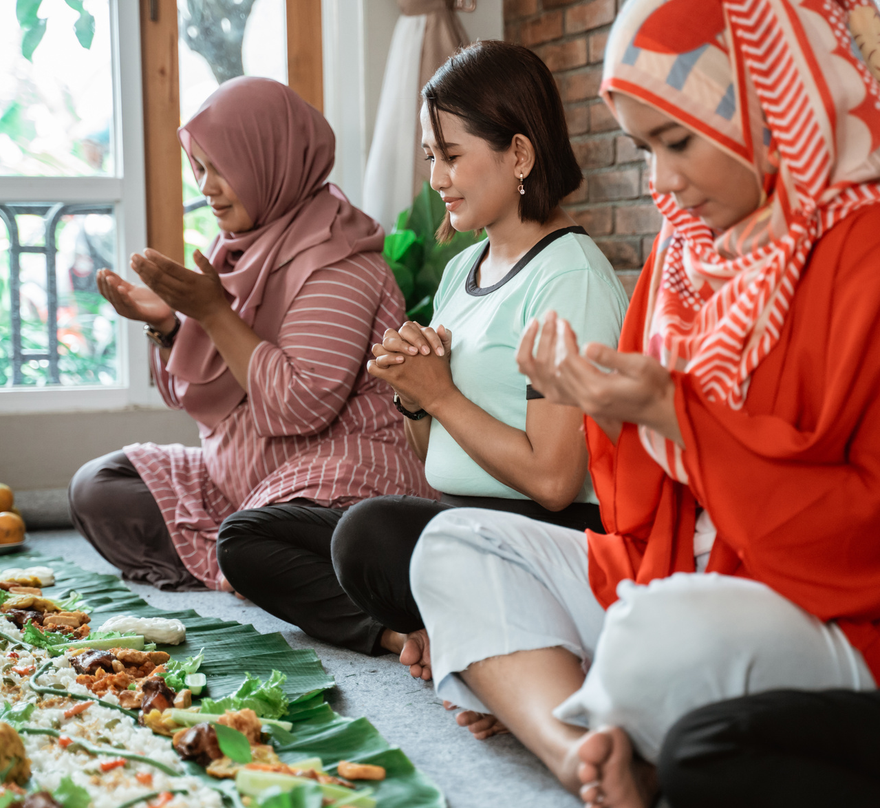


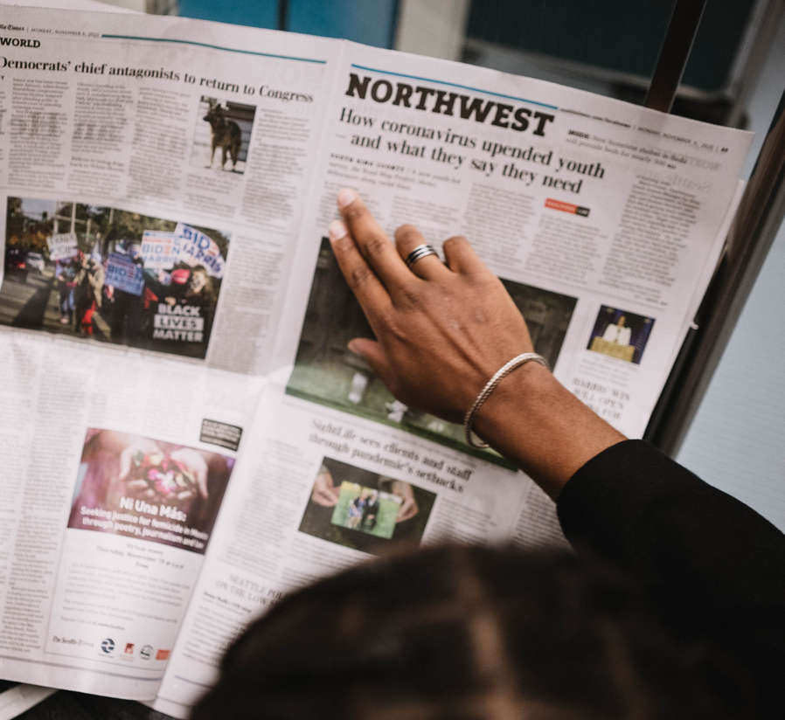

Lifestyle
Entertainment
Personal Finance
Culture
Our Primary Audience Segments
+200 Sub-audience segments
Sports
High Net Worth
News
Education
Notes:
SLIDE OPTION 1

Slide 15












Display Ads
Video Ads
Audio Ads
CTV/OTT Ads
DOOH Ads
High SOV Ads
Our Offerings
Text Messages
Content Sponsorships
Social Outreach
Brand Engagement Solutions
Newsletters
Microsites

Slide 16
A Glimpse At Our Selected Offerings

Slide 17

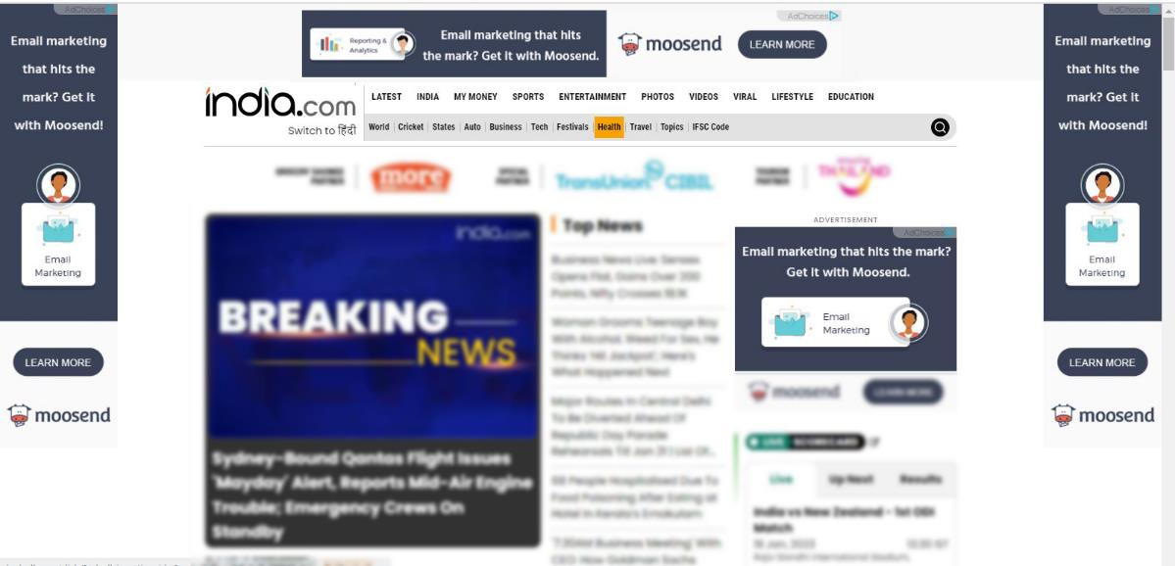
High Share Of Voice Ads
Home Page Take Over
Desktop View
Mobile View

Slide 18
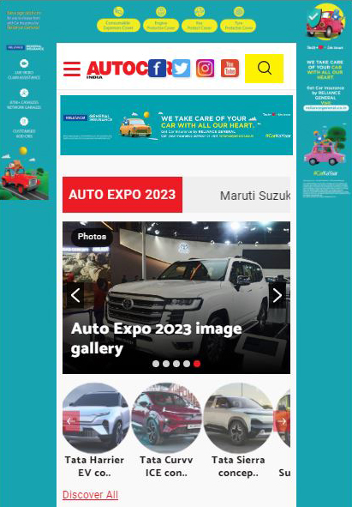
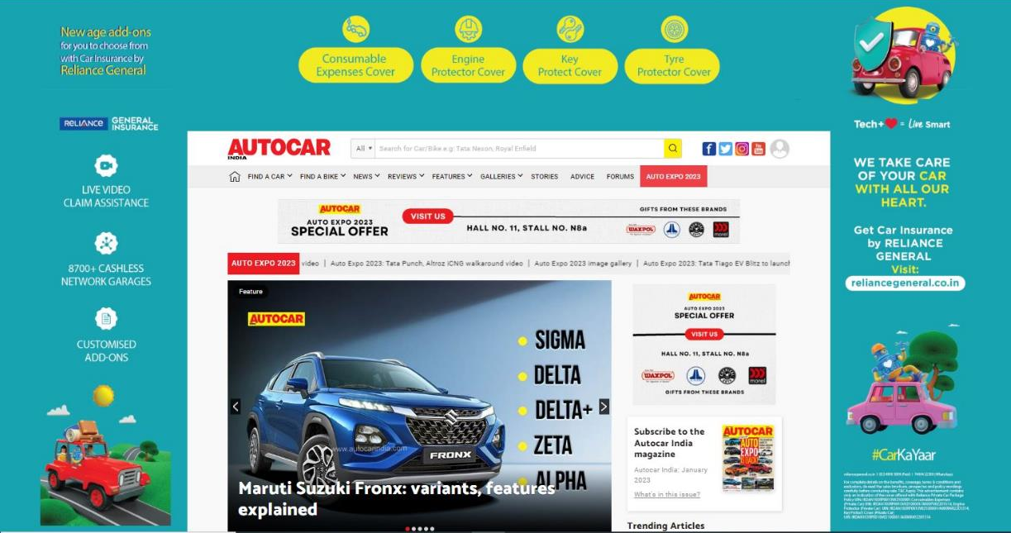
High Share Of Voice Ads
Desktop View
Mobile View

Slide 19

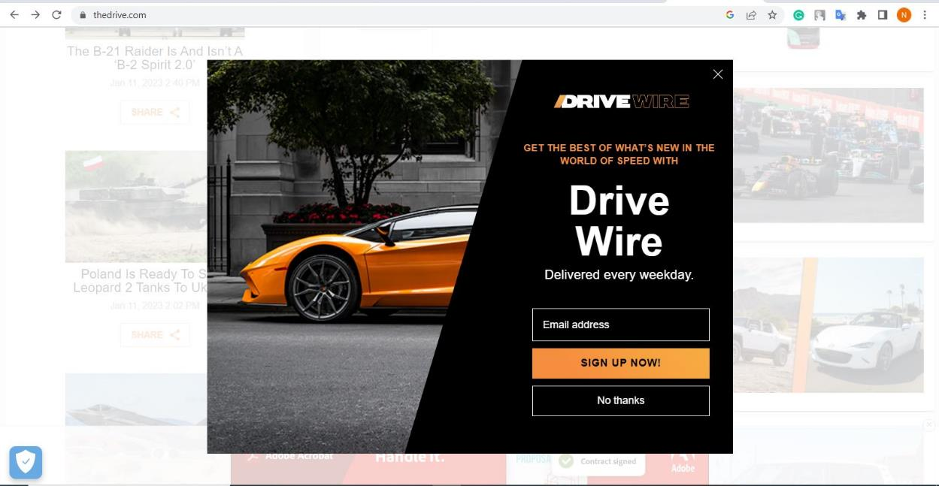
High Share Of Voice Ads
Full Page Interstitial
Desktop View
Mobile View

Slide 20
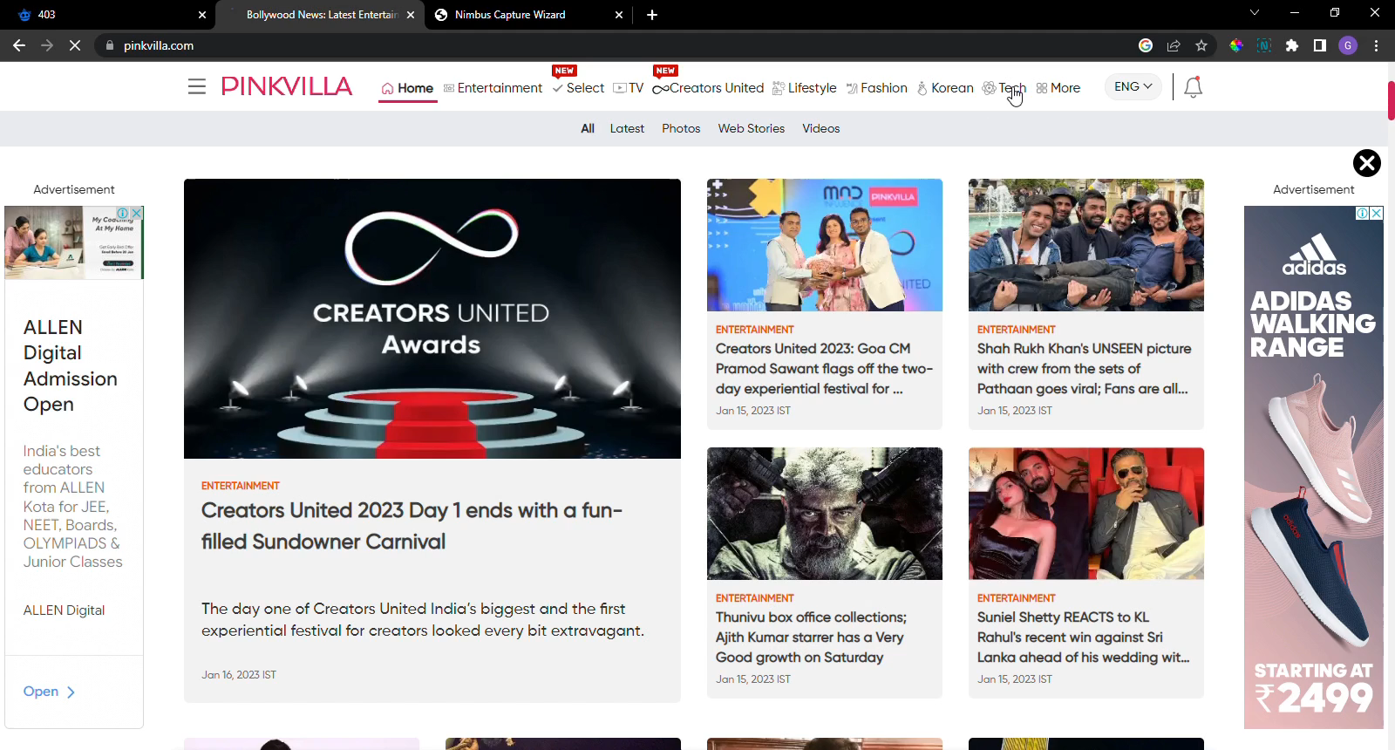
Content Sponsorships
Brand sponsored articles on well known websites.
Brand OnePlus Sponsored articles with Indian publisher Pinkvilla
Notes:
Screenshort is a video

Slide 21
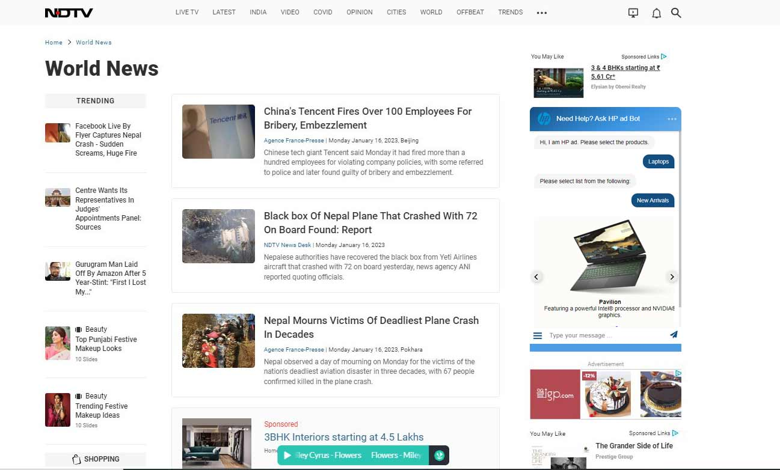
Brand Engagement Solutions
Chatbot Creative

Slide 22
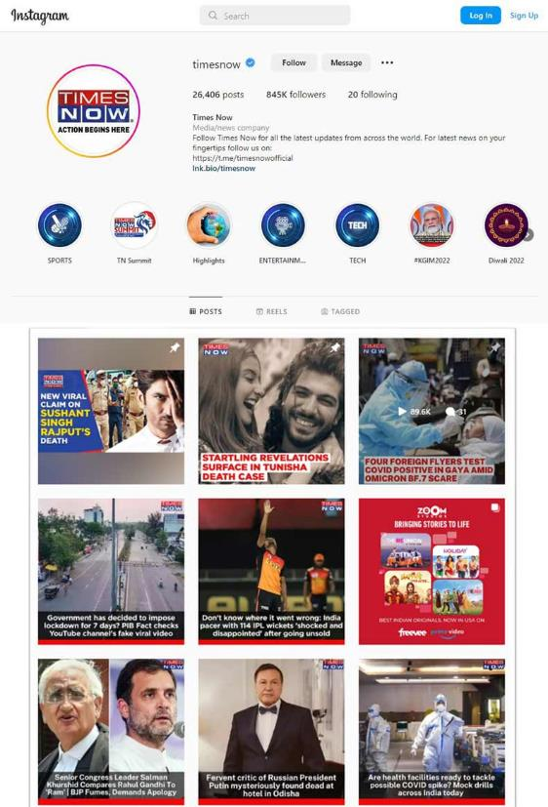
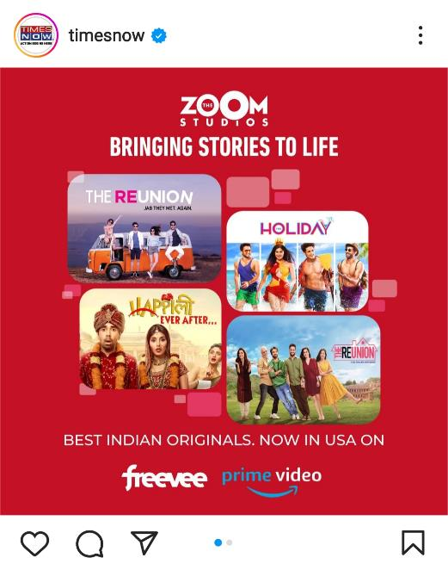
Social Outreach
Sponsored social media segments: Carousels, Videos, Reels & more tagged with the brand’s social handle.

Slide 23
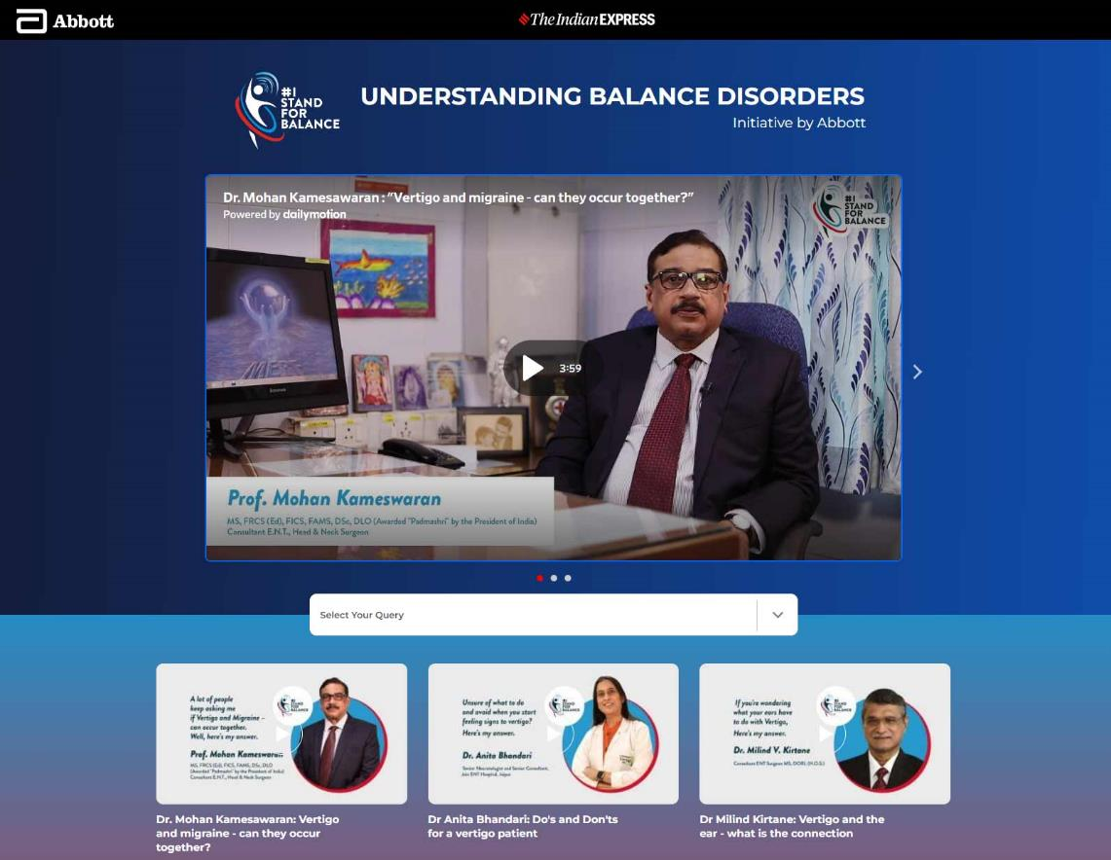
Microsites

Slide 24

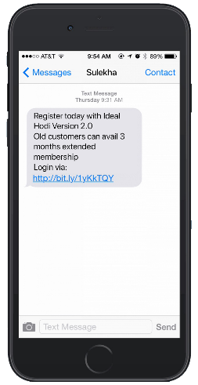
Text Messages & Newsletters
Text Messages
Newsletters

Slide 25





How We Can
Work Together?
v
Managed Media Buy
PMP & PG Available
via
Programmatic Pipes

Slide 26
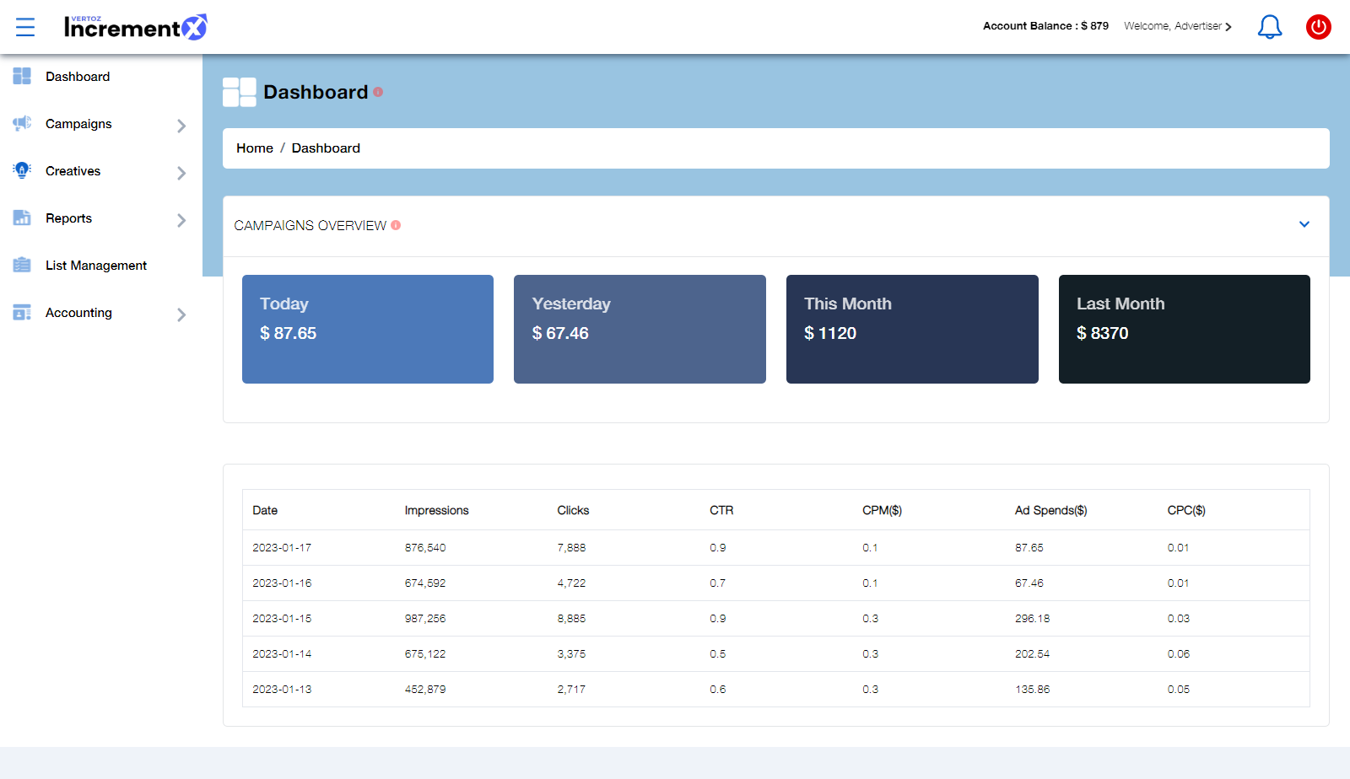
Our Technology
Advertisers Dashboard

Slide 27





Our Targeting Capability
Ethnicity
Geo Targeting
Direct connect to Asian audience consumer behavior
State / DMA / City / Postal Code
Contextual Category
Audience Buckets
Sites & Apps
Entertainment / Autos & Vehicles / Beauty & Fitness / Books & Literature
Finance / Health / News / Online Communities /
Leisure / Sports / Travel
News 18 / Indian Express / China Times / Korean Radio

Slide 28











Why IncrementX?
One Stop Solution - Asian Audience
First Party Audience Buckets
Local Support
Cultural Knowledge
Multiple Languages
Delivery, Quality & Scale
Innovations & Ad formats
Experience
Technology

Slide 29


About IncrementX
IncrementX is the technology led Niche audience platform representing Asian Digital Publishers in their unrepresented geography.
IncrementX is the Programmatic Monetization and Brand Solutions Partner for Publishers.
We provide a global sales force, partnerships & technologies unique expertise to minimize the surprises publishers face in unrepresented geographies.
IncrementX is Part of Vertoz Group (NSEI: VERTOZ)

Slide 30




Thank You

