Slide 1


MEDIA REPRESENTATION

Slide 2


WHO WE ARE?
IncrementX is the technology-led Niche audience platform representing Asian Digital Publishers in their unrepresented geography.
We help Brands and Advertisers in reaching desired Niche Audiences.
IncrementX is the Programmatic Monetization & Brand Solutions Partner for Publishers worldwide.
We provide a global sales force, partnerships & technologies with unique expertise to minimize the surprises publishers face in unrepresented geographies.
IncrementX is Part of Vertoz Group (NSEI: VERTOZ)

Slide 3








WE UNDERSTAND PUBLISHER CHALLENGES
Most of the Asian Publishers have following Challenges in the Western Market for their Advertising Revenue.
Super Crowded Market
Local Office
Comparable Yield
Differentiation
Direct Brand and
Agency Demand
Local Relationships

Slide 4



OUR OFFERINGS
Representation of the Digital Publishers in their Unrepresented Geography for Smarter Revenue.
Programmatic Monetization
Brand Solutions
We drive Publishers Programmatic Monetization
and Brand Solutions through our Representation service.

Slide 5






MARKETS WE REPRESENTS
24Mn
7Mn
5.5Mn
19.9M people identified as Asian alone & 4.1M people identified as Asian in combination with another race.
7M Canadians are of Asian geographical descent
5.5M Asians make up 9.3% of the total population of England & Wales

Slide 6





HOW WE DRIVE
PROGRAMMATIC MONETIZATION?
IncrementX represents publishers in the programmatic ecosystem.
Open Market Yield Optimization
Whitelisting Sites & Apps
Aggregated PMPs
PGs
Working Directly on Publisher’s first party audiences and bundling them via various deals drives higher efficiency for brands and yields for publishers.

Slide 7





HOW WE DRIVE
BRAND SOLUTION REVENUE?
IncrementX offers brand solution demand to the publisher.
Marketing Support
Local Sales Force
Direct connections and relationships
Direct Deals (IOs)

Slide 8













Display Ads
Video Ads
Audio Ads
CTV/OTT Ads
DOOH Ads
High SOV Ads
OUR AD FORMATS
Text Messages
Newsletters
Content Sponsorships
Social Outreach
Brand Engagement Solutions
Microsites

Slide 9

A GLIMPSE AT OUR SELECTED OFFERINGS

Slide 10

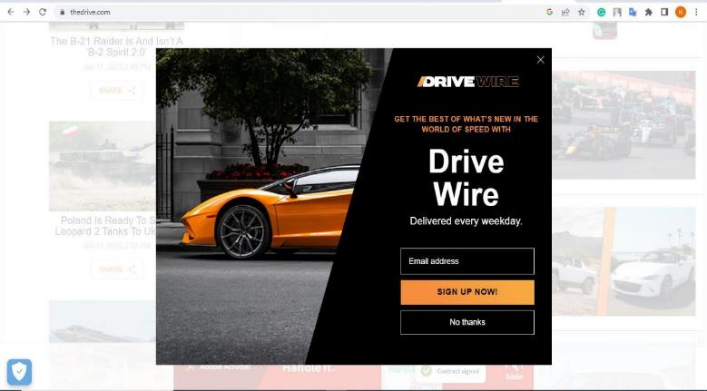
HIGH SHARE OF VOICE ADS
Full Page Interstitials
Desktop View
Mobile View
Notes:
SLIDE OPTION_1

Slide 11
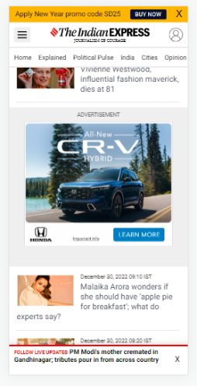
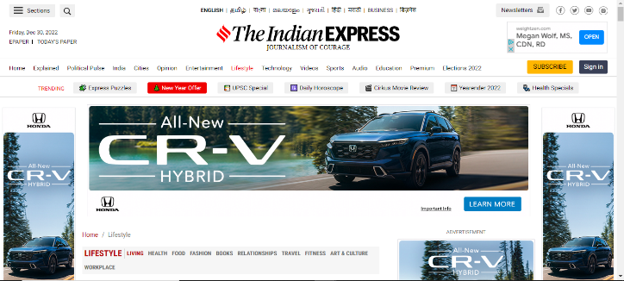
HIGH SHARE OF VOICE ADS
Home Page Take Overs (HPTO)
Desktop View
Mobile View

Slide 12
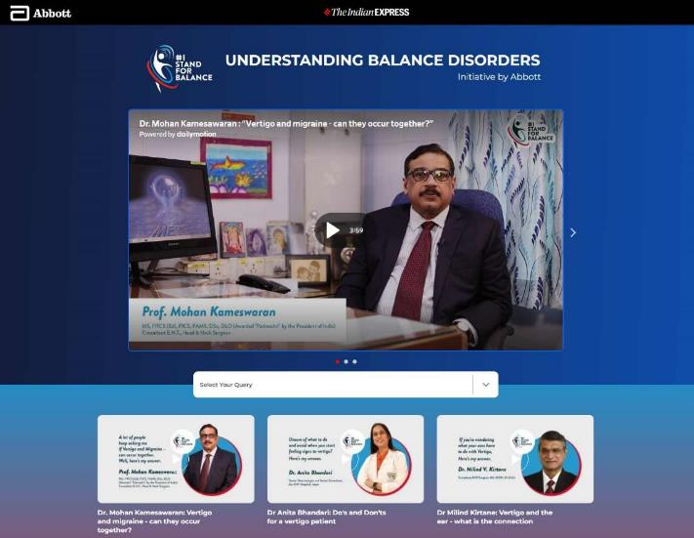
MICROSITES

Slide 13
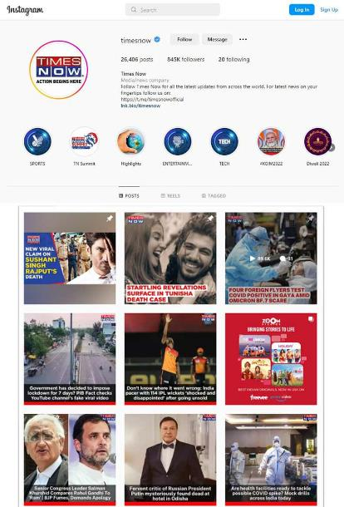

SOCIAL
OUTREACH

Slide 14

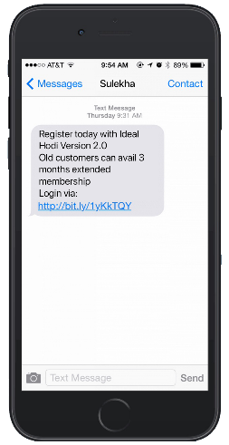
Text Messages & Newsletters
Text Messages
Newsletters

Slide 15

OUR INTEGRATION OPTIONS
JS Tags
Header Bidding
Video-VAST Tags
Open RTB
PROGRAMMATIC
MONETIZATION
BRANDS
SOLUTIONS
Publisher Served –
Custom Creative /
Content

Slide 16
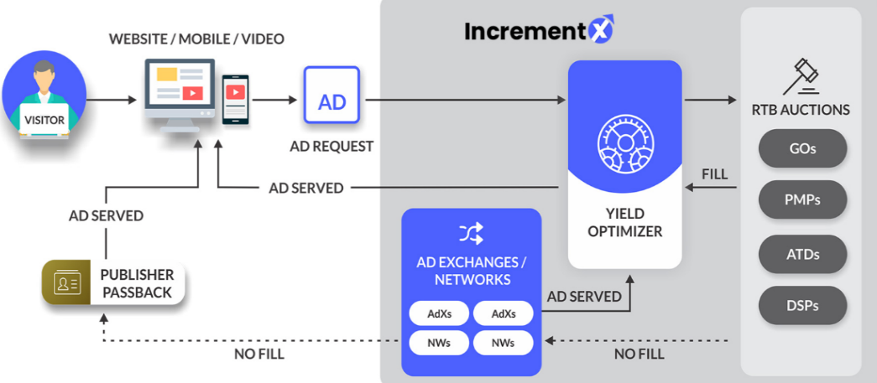
PROPRIETARY
TECHNOLOGY

Slide 17
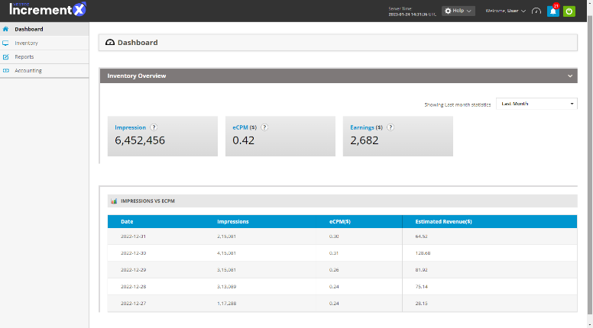
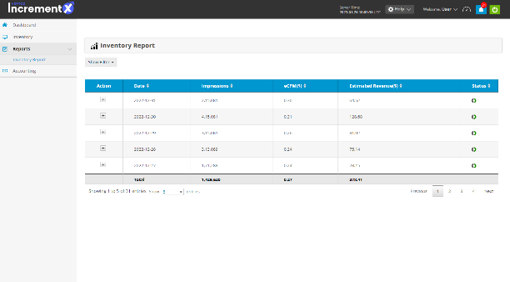
OUR CONSOLE
Dashboard
Reports

Slide 18






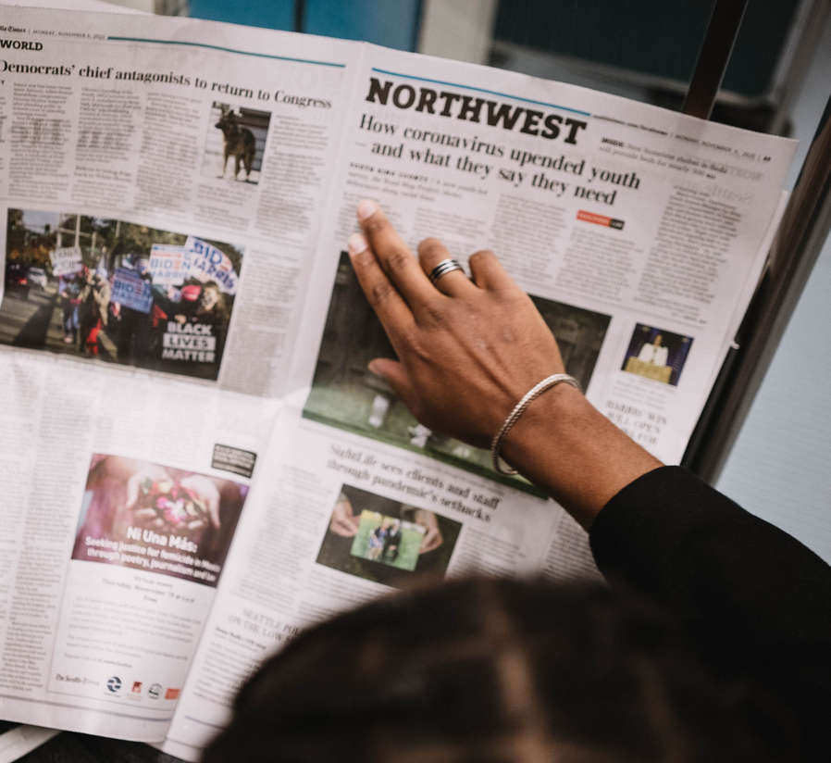

Lifestyle
Entertainment
Personal Finance
Culture
AUDIENCE SEGMENTS
+200 Sub-audience segments
Sports
High Net Worth
News
Education
Notes:
SLIDE OPTION 1

Slide 19

















































PUBLISHERS WHO TRUST US
We Represent Over 15 Asian Countries Publishers
South Asian
(India, Pakistan, Bangladesh, Nepal, Shri Lanka)
Southeast & East Asian
(China, Japan, Vietnam, Philippines, South Korea, Indonesia )
Creaders
Radiokorea
Bangladesh Pratidin
Dainik Bhaskar
Urdu Point
Punjab Kesari
The Korea Daily
Dinamalar
Prothom Alo
Missyusa
The Korea Times
Sandesh
Vikatan
FM Korea

Slide 20
























WE CONNECT YOU TO TOP BRANDS & AGENCY
Notes:
Put some Agency – WPP / IPG / RPA / Mindshare / Innitiative etc..

Slide 21






SELECT DEMAND PARTNERS
Notes:
Update this Image – Show Partners – Handshake type image

Slide 22
OUR PROPOSAL
We are true believers of “the Skin in the Game in partnership model”
and our proposal is structured accordingly.
Revenue Share
Open Market Monetization (Programmatic)
PMPs/PGs (Programmatic)
Direct Deals (Brand Solutions)
Revenue Share
Up-to 90%
Up-to 70%
Up-to 60%
Payment Terms
30 to 45 Days
30 to 45 Days
Based on Collection - Generally 60-90 Days
Notes:
Open Market upto 90%
PMP & PG upto 75%
Brand Solutions - Customized

Slide 23

WHY INCREMENTX?
Awareness in Unrepresented Market
Extended Local Team
Niche Audience Aggregator
Local Demand Partner
Audience Bucketing
Direct Brand & Agency Demand
Value Creation- Matching right demand
Premium, Unique Demand

Slide 24
Milestone/Task | Status | Date | Owner
Introduction - 30 Mins |  |  | IX PD + Publishers
Representation MSA Execution |  |  | Publisher
Ads.txt & Google MCM Invite |  |  | IX Ad Ops Team
Tags Implementation - Test Page |  |  | Publisher
Inventory Review with Sales Team |  |  | IX PD & SD Team + Publisher
Go Live – 5% of US,CA & UK Traffic |  |  | Publisher
Brand Solution – Prices Review |  |  | IX PD & SD Team + Publisher
Scale Up Traffic |  |  | Publisher
First IO / Deals |  |  | IX PD & SD Team
MUTUAL ACTION PLAN
Notes:
Open Market upto 90%
PMP & PG upto 75%
Brand Solutions - Customized

Slide 25
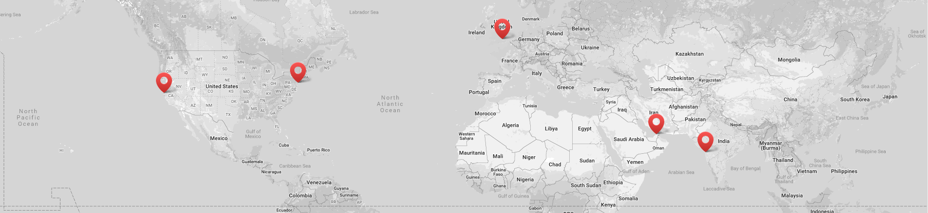





GLOBAL PRESENCE
Vertoz Inc
Vertoz Inc
Vertoz Ltd
Vertoz Advertising FZ-LLC
Vertoz Advertising Ltd
1250 Broadway,
Suite 3611,
New York City,
New York - 10001, USA.
T +1 646 895 6969
50 California
Street Suite 1500,
San Francisco,
CA 94111 USA.
T +1 415 300 4333
Kimberley House,
31 Burnt Oak Broadway,
Edgware, Greater
London – HA8 5LD, UK
T +44 20 3318 4422
EX-34,
Ground Floor, Bldg 16,
Dubai Internet City,
Dubai – 73000, UAE
602, Avior,
Nirmal Galaxy,
LBS Marg, Mulund West,
Mumbai – 400080, India
T +91 22 6142 6030

Slide 26



Thank You

