Slide 1




Niche
Asian American
Audiences

Slide 2

















We Represent Asian American Ethnicities
The term “Asian American” encapsulates dozens of ethnic groups of Asian descent.
According to 2020 Census 19.9M people identified as Asian alone & 4.1 million people identified as Asian in combination with another race.
4.8M
4.1M
2.9M
1.8M
South Asian
Chinese
Filipino
Vietnamese
1.5M
771K
172K
1.2M
Chinese
(Approx)
…
Korean
Japanese
Taiwanese
Others
Source: https://www.census.gov/library/stories/2022/05/aanhpi-population-diverse-geographically-dispersed.html

Slide 3
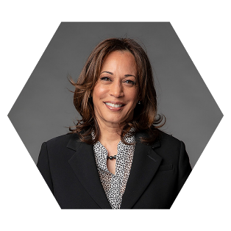
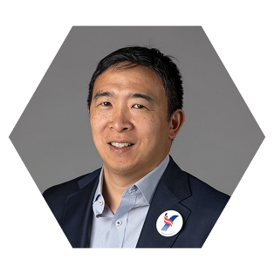

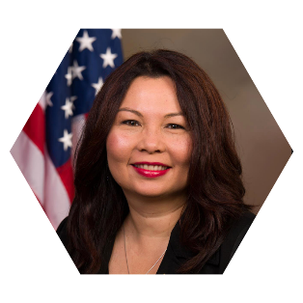






Reaching Niche Asian Americans
Early Tech Adopters, Highly Educated And Affluent.
Taiwanese Origin
Thai Origin
Part Indian Origin
Indian Origin
Indian Origin
Kamala Harris
Vice President of the US
Andrew Yang
Politician & Attorney
Satya Nadella
CEO of Microsoft
Tammy Duckworth
Jr. US senator from Illinois
Sundar Pichai
CEO of Google

Slide 4




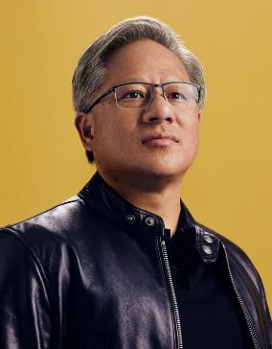





We Deliver The Asian American Market
The Asian market is growing and has arrived!
Eric Thich Vi Ly Founder LinkedIn
(Vietnamese Origin)
Hasan Minhaj
Comedian
(Indian Origin)
Mindy Kaling
Actress
(Indian Origin)
Will Yun Lee
Actor
(Korean Origin)
Jensen Huang
Founder NVIDIA
(Taiwanese Origin)
Jhumpa Lahiri
Author / Writer
(Indian Origin)
Daniel Tani
Astronaut
(Japanese Origin)
Vera Wang
Fashion Designer
(Chinese Origin)
Kumail Nanjiani
Actor
(Pakistani Origin)
Dave Bautista
Actor
(Filipino Origin)

Slide 5

Asian American
A Rapidly Growing Market!
90%
Growth In Population
Population Growth
The Asian American population currently stands at 24 Million.
SINCE 2000 FOR ASIAN AMERICANS
25,000
Asian American Population
Total Population Trend Line
22,613
The Asian-American population grew 46% in the past 10 years.
20,000
Fastest growing ethnic group in the US.
15,000
This population is projected to increase by 143% in the coming decades.
10,000
11,899
5,000
980
114
2060 Population projection : 49 Million
0
1900
1960
2000
2018
Source: https://www.sciencedirect.com/topics/medicine-and-dentistry/asian-american-population

Slide 6






Why Asian Audience ?
AGE
INCOME
60% of US born Asians belong to Gen Z or younger age bracket.
The average Asian American Household Income was around $102K highest compared to any other ethnicity. (2021)
GENDER
EDUCATION
Total Asian American Female population was 9.65 Million & Male population was 8.78 Million as of 2020.
87.8% of all Asians in the US aged 25 & older have a bachelor’s degree or more education.
Source: https://www.nytimes.com/interactive/2021/08/21/us/asians-census-us.html
Source: https://www.pewresearch.org/fact-tank/2021/04/29/key-facts-about-asian-americans/
Notes:
Median age of U.S.-born Asians was just 19 – compared with 36 among all U.S.-born people in 2019
Asian American women’s share of the total female population will grow from 5.14 percent in 2012 to 7.8 percent in 2050.

Slide 7
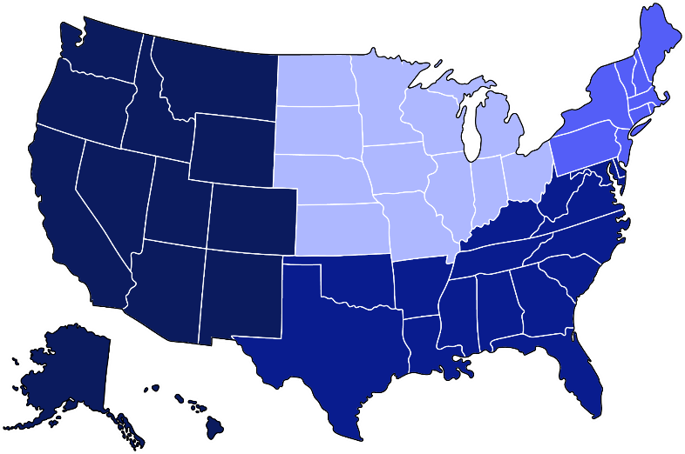
Asians In America.
Major Markets.
Nearly half of all Asian Americans live in the West
% of the Asian population in U.S., 2019.
STATE | POPULATION
California | 6.7M
New York | 1.8M
Texas | 1.6M
New Jersey | 950K
Washington | 854K
Illinois | 828K
Hawaii | 803K
Florida | 763K
Virginia | 691K
Massachusetts | 538K
Midwest
2.7 million
12%
West
9.8 million
45%
Northeast
4.2 million
19%
South
5.3 million
24%
Source: https://www.pewresearch.org/fact-tank/2021/04/29/key-facts-about-asian-americans/ft_2021-04-29_asiankeyfacts_04/
Source: https://worldpopulationreview.com/state-rankings/asian-population

Slide 8
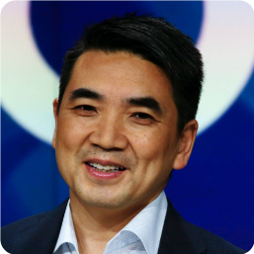





Opportunity - Educated, Young & Leaders of Tomorrow.
7.2M
People
581K
Businesses
Eric Yuan
CEO & Founder of Zoom
Bachelor's degree in applied mathematics &
Master's degree in geology engineering
Asians have a bachelor’s degree or higher level of education.
The median age of
U.S.-born Asians is just
33
The number of
Asian-owned employer firms in the US. [2019]
Source:
2016-2020 American Community Survey, 5-Year Estimates
Source:
2016-2020 American Community Survey, 5-Year Estimates
Source:
2020 American Business Survey, data year 2019
Amar Bose
Founder Bose
PhD in Electrical Engineering from MIT

Slide 9

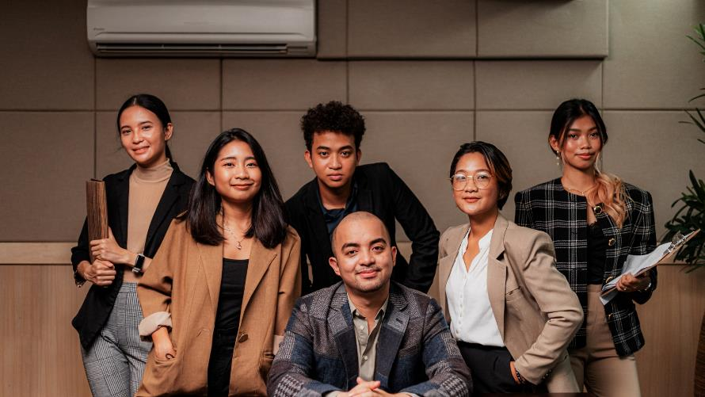
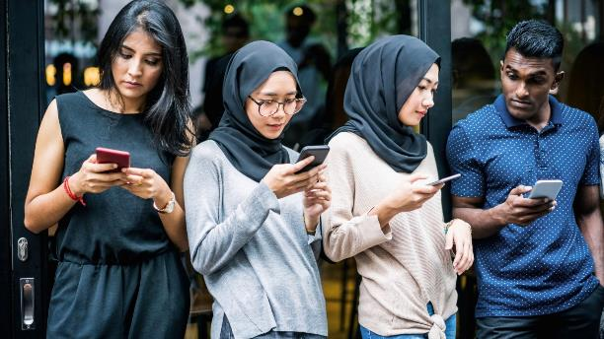
Asian Affluency
Contribution to Economy
Asian-owned businesses make up 10% of all businesses in the US.
Top Companies like Adobe, Alphabet, Microsoft, NVIDIA, FedEx, & HubSpot, have Asians at the helm.
Asians place a high value on higher education.
One of their core beliefs is the formation of stable, tight-knit families.
Source: https://fortune-com.cdn.ampproject.org/c/s/fortune.com/2022/12/16/indians-taking-over-corporate-america-tech-layoffs-visas-ceos-companies-success-nitinbajaj/amp/https://blogs.loc.gov/inside_adams/2021/05/asian-american-business/
Notes:
Indian-owned businesses in the US have a total market capitalization of more than $6 trillion.

Slide 10


Multicultural Marketing Is Mainstream Marketing
The biggest opportunity for market growth is the “multicultural market.” In the past 10 years, 100% of U.S. population growth came from increases in the Black, Hispanic, Asian, Pacific Islander, Native, Indigenous, multi racial & multi-ethnic segments of the population with buying power worth more than $5 trillion.
“Today I work in two industries, tech and advertising, that I believe care deeply about diversity but where old habits have held back progress. As Google’s CMO, I know it’s my job to help change this.”
Marc S. Pritchard
Chief Brand Officer at P & G
Lorraine Twohill
Chief Marketing Officer at Google

Slide 11

Notes:
Play video

Slide 12





















Brands Who Buy Asian Audiences.

Slide 13



















































Our Premium Asian Publishers Network
South Asian
(India, Pakistan, Bangladesh, Nepal, Shri Lanka)
Southeast & East Asian
(China, Japan, Vietnam, Philippines, South Korea, Indonesia )
Creaders
Radiokorea
Bangladesh Pratidin
Urdu Point
Dainik Bhaskar
Punjab Kesari
The Korea Daily
Dinamalar
Prothom Alo
Missyusa
The Korea Times
Sandesh
Vikatan
FM Korea
Notes:
Added Radio Korea, Creaders (China), Missy USA

Slide 14






Scale Available With Us.
1BN+
Video Imp (Mo.)
800MN+
Display Imp (Mo.)
18+
General Market
v
1.8BN+
Total Impressions (Mo.)
18MN+
Reach/Uniques
300+
Premium Publishers

Slide 15






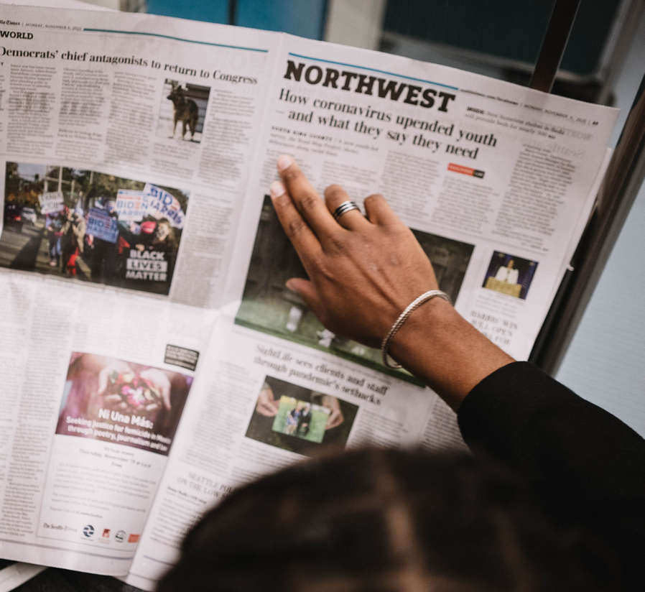

Lifestyle
Entertainment
Personal Finance
Culture
Our Primary Audience Segments
+200 Sub-audience segments
Sports
High Net Worth
News
Education
Notes:
SLIDE OPTION 1

Slide 16













Display Ads
Video Ads
Audio Ads
CTV/OTT Ads
DOOH Ads
High SOV Ads
Our Offerings
Text Messages
Content Sponsorships
Social Outreach
Brand Engagement Solutions
Newsletters
Microsites

Slide 17
A Glimpse At Our Selected Offerings

Slide 18

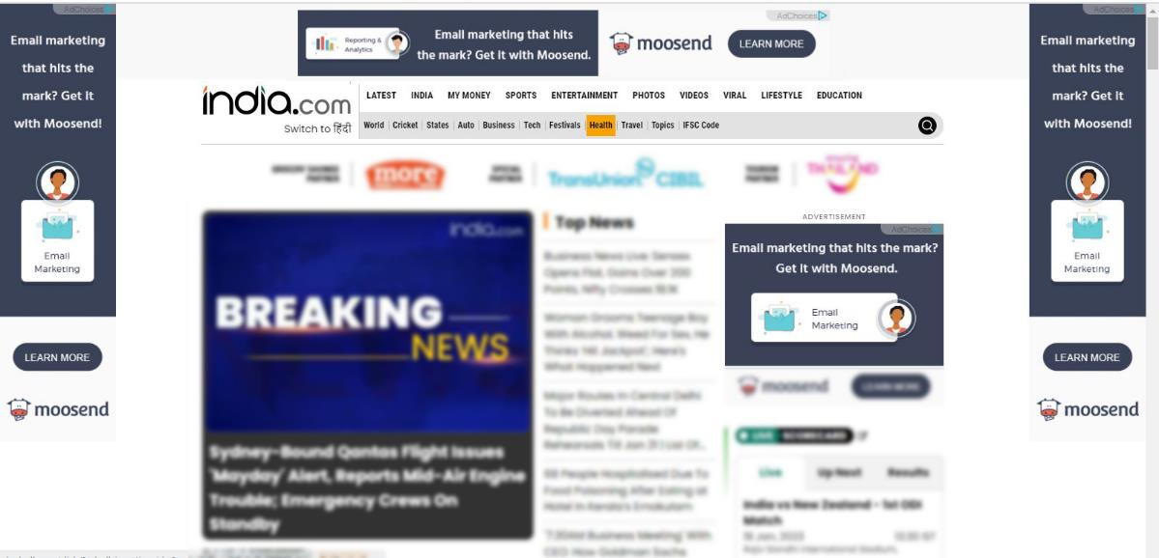
High Share Of Voice Ads
Home Page Take Over
Desktop View
Mobile View

Slide 19


High Share Of Voice Ads
Desktop View
Mobile View

Slide 20


High Share Of Voice Ads
Full Page Interstitial
Desktop View
Mobile View

Slide 21
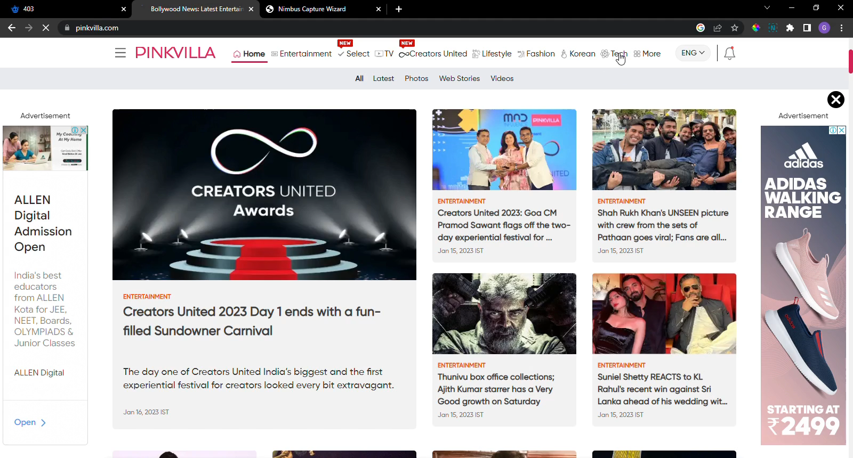
Content Sponsorships
Brand sponsored articles on well known websites.
Brand OnePlus Sponsored articles with Indian publisher Pinkvilla

Slide 22
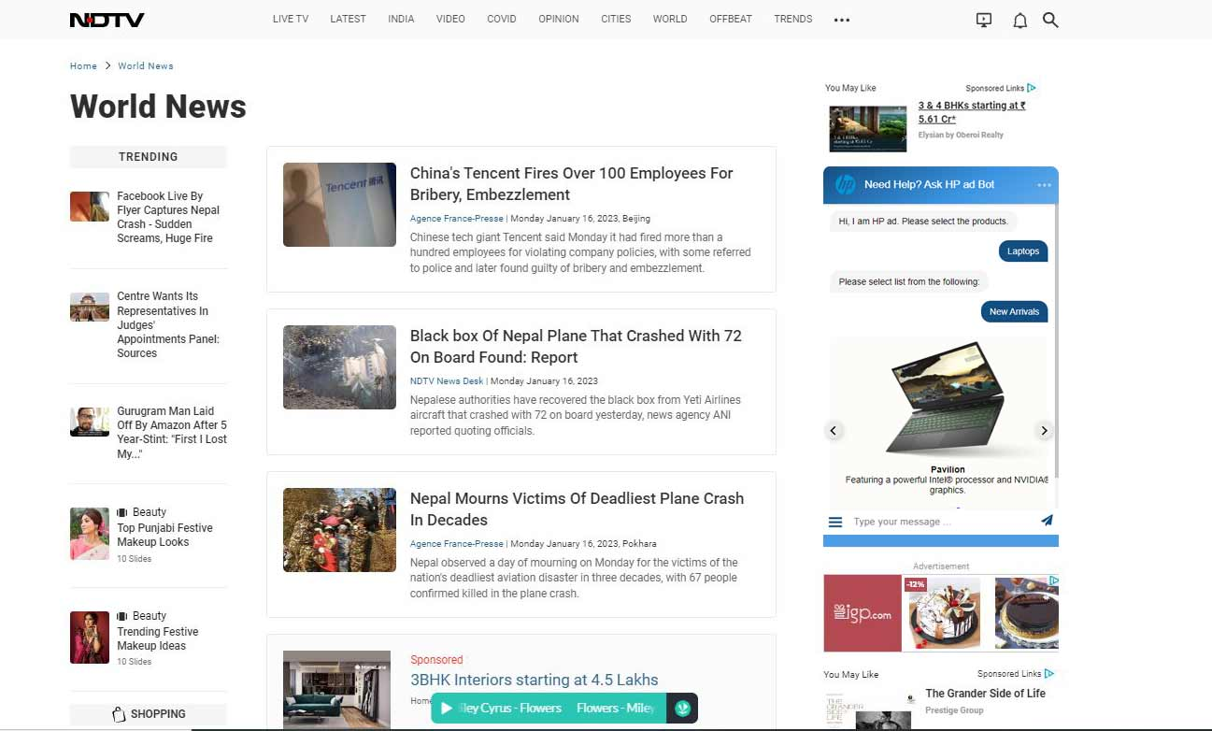
Brand Engagement Solutions
Chatbot Creative

Slide 23
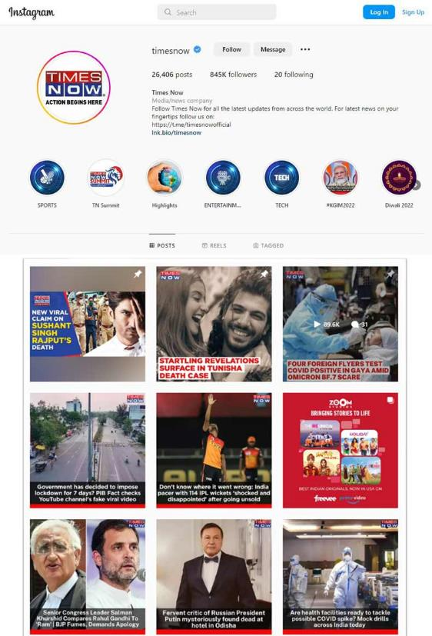

Social Outreach
Sponsored social media segments: Carousels, Videos, Reels & more tagged with the brand’s social handle.

Slide 24
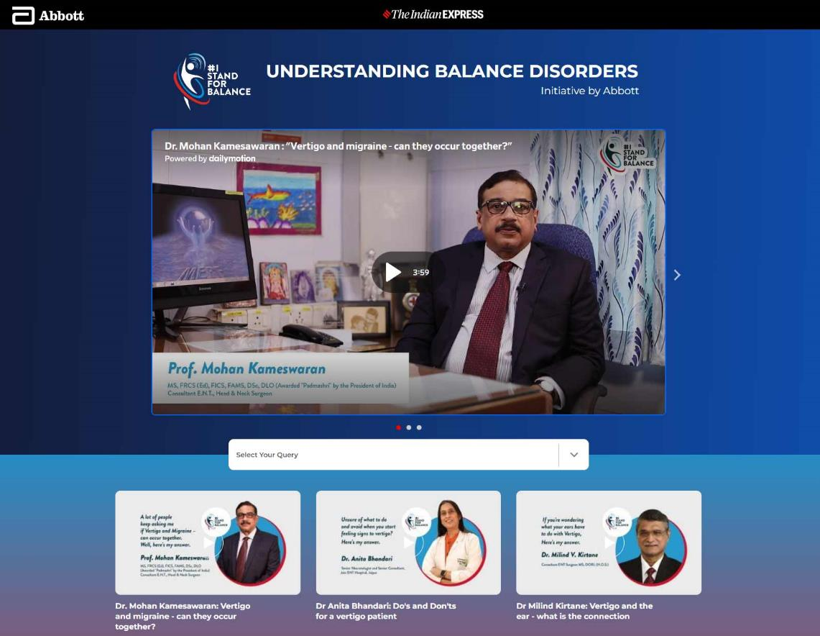
Microsites

Slide 25


Text Messages & Newsletters
Text Messages
Newsletters

Slide 26





Here’s How We Can Work Together.
Managed Media Buy
Programmatic Pipe
PMP & PG Available via

Slide 27
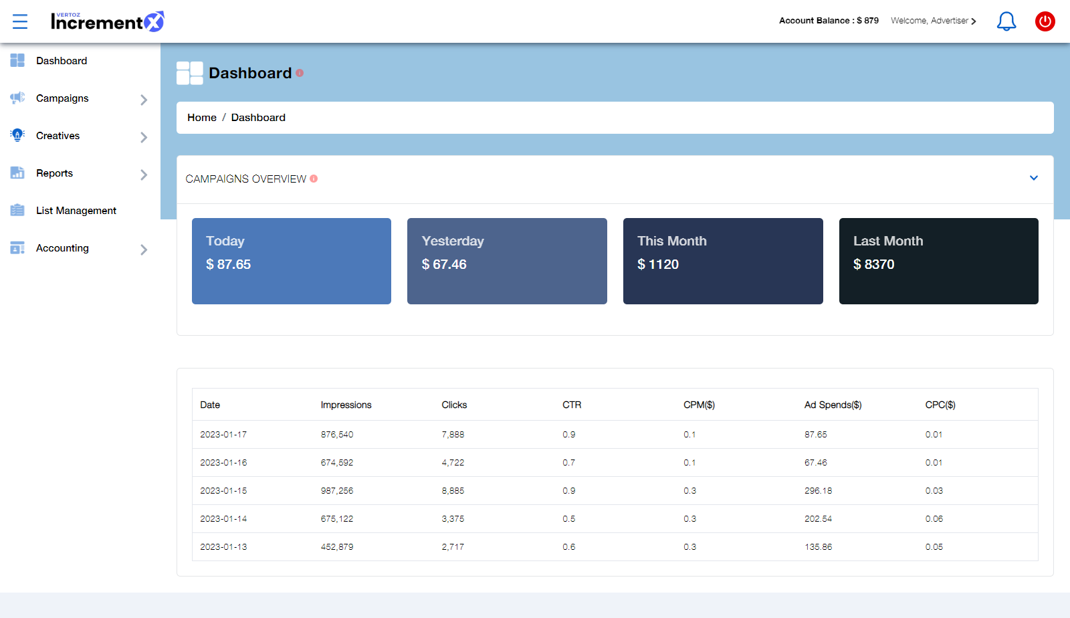
Our Technology
Advertisers Dashboard

Slide 28






Ethnicity
Our Targeting
Capabilities
Geo Targeting
Direct connect to Asian audience consumer behavior
State / DMA/ City / Zip Code
Contextual Category
Audience Buckets
Sites & Apps
Entertainment / Autos & Vehicles / Beauty & Fitness / Books & Literature
Finance / Health / News / Online Communities /
Leisure / Sports / Travel
News 18 / Indian Express / China Times / Korean Radio

Slide 29









Why IncrementX ?
One Stop Solution - Asian Audience
First Party Audience
Local Support
Cultural Knowledge
Multiple Languages
Delivery, Quality & Scale
Innovative Ad formats
Technology

Slide 30


About IncrementX
IncrementX is the technology led Niche audience platform representing Asian Digital Publishers in their unrepresented geography.
IncrementX is the Programmatic Monetization and Brand Solutions Partner for Publishers.
We provide a global sales force, partnerships & technologies unique expertise to minimize the surprises publishers face in unrepresented geographies.
IncrementX is Part of Vertoz Group (NSEI: VERTOZ)

Slide 31
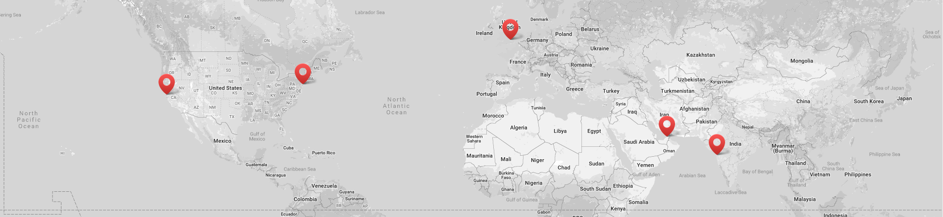






Global Presence
Vertoz Inc
Vertoz Inc
Vertoz Ltd
Vertoz Advertising FZ-LLC
Vertoz Advertising Ltd
1250 Broadway, Suite 3611, New York City,
New York - 10001, USA.
T +1 646 895 6969
50 California
Street Suite 1500,
San Francisco,
CA 94111 USA.
T +1 415 300 4333
Kimberley House,
31 Burnt Oak Broadway,
Edgware, Greater
London – HA8 5LD, UK
T +44 20 3318 4422
EX-34,
Ground Floor, Bldg 16,
Dubai Internet City,
Dubai – 73000, UAE
602, Avior,
Nirmal Galaxy,
LBS Marg, Mulund West,
Mumbai – 400080, India
T +91 22 6142 6030

Slide 32






Thank You

